Slide 1
NHS Gloucestershire ICB Organogram
January 2023

Slide 2
About NHS Gloucestershire ICB
We were established as an Integrated Care Board on 1 July 2022
We are responsible for 168 statutory functions as well as a collection of new
duties that seek to promote collaborative working with our partners across
Gloucestershire’s health and care services
We serve a population of 652,475
We have an annual budget of £1.2bn
We are responsible for commissioning:
Hospital services
Mental health services
Primary care
Community services such as district nursing and we work jointly with the local authority Gloucestershire County Council to deliver community services to our residents
Ambulance services

Slide 3
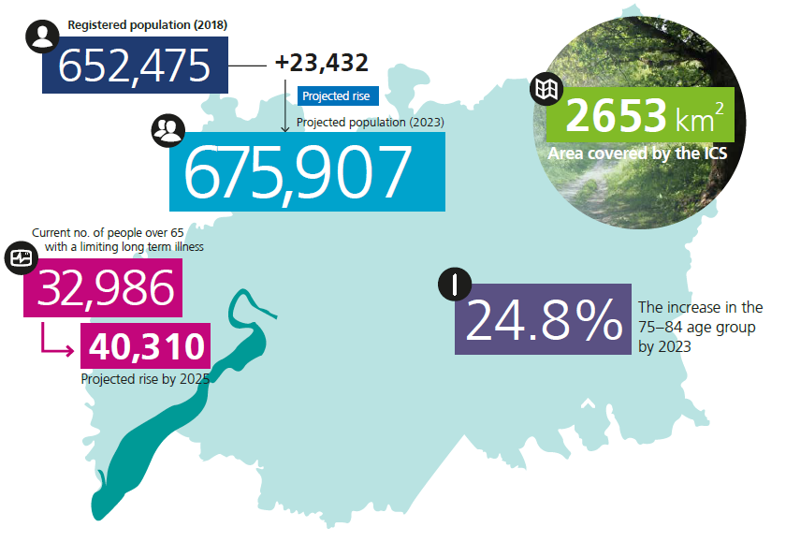
Overview of Gloucestershire
Gloucestershire has a population of 652,475 – expected to rise to 675,000 by 2023.
The proportion of the population aged 75-84 has increased by 20% between 2016 and 2021.
The number of people over 65 with a long term condition is due to increase to 77,000 by 2030.
Gloucestershire has a lower proportion of 0-19 year olds and 20-64 year olds and a higher proportion of people aged 65+.
The county has a net loss of young people with a net movement of over 400 people aged between 18-30 leaving the county each year.
There are pockets of both urban and rural deprivation.
Life expectancy is 7.7 years lower for men and 5.4 years lower for women in the most deprived areas of Gloucestershire than in the least deprived areas.
652,475 population
Over 10,000 staff
1,500 medical staff
360 GPs / 71 practices
1 Local Authority
1 Acute Hospital Trust (2 sites)
1 Integrated Care Board
1 Place Based Partnership
1 Mental Health & Community Trust
6 Integrated Locality Partnerships & 15 Primary Care Networks
1 PCCC and Police Authority
6 District Councils
University of Gloucestershire

Slide 4
NHS Gloucester ICB Structure Charts and associated staff management costs at 6 January 2023
The following slides capture the NHS Gloucestershire Integrated Care
Board organogram information, as of 06 January 2023 and include:
Executive Team portfolio summaries staff salary costs per directorate
Chair and Non-Executive structure and salary costs
Please note the following
The totals show salary costs but do not include employer’s oncosts.
Salary bands have been grouped so no individual and associated salary is identifiable.
A number of teams are patient or service facing and therefore have no associated administration costs
The cost and headcount information is based on running cost budget information excluding non-pay budgets, Commissioning Support Unit contracts and programme budgets.

Slide 5
ICB Executive Structure
Chief Executive Officer
Chief Finance Officer
Chief Medical Officer
Chief Nursing Officer
Deputy CEO/Director of Strategy & Transformation
Director of People, Culture & Engagement
Director of Primary Care & Place
Director of Operational Planning & Performance
Director of Integration
Chief Clinical Information Officer
Headcount | Management cost
186 | £7,829,004
Non-executives | £138,000
NB. These charts reflect staff roles within the ICB running costs, and reflects the costs of staff salaries excluding employers on-costs

Slide 6
Strategy & Transformation Directorate
Director of Strategy & Transformation
Urgent & Emergency Care
Transformation Programmes
Programme Management Office
Band | Headcount
VSM | 1
9 | 1
8d | 1
8b | 1
8a | 2
7 | 1
6 | 2
5 | 2
4 | 1
Total | 12
Directorate Annual Staff Management cost | £686,879
NB. These charts reflect roles within the ICB running costs

Slide 7
Integration Directorate
Director of Integration
Integrated Commissioning Team
Continuing Healthcare
Band | Headcount
VSM | 1
Band 8d | 1
Band 8c | 3
Band 8b | 2
Band 8a | 8
Band 7 | 9
Band 6 | 3
Band 5 | 2
Band 4 | 3
Band 3 | 2
Total | 34
Directorate Annual Staff Management cost | £899,070
NB. These charts reflect roles within the ICB running costs

Slide 8
Operational Planning & Performance Directorate
Director of Operational Planning & Performance
Estates (primary care & strategic estates)
Contracts & Procurement
Planned Care
Performance Management
Band | Headcount
VSM | 1
Band 8d | 3
Band 8c | 2
Band 8b | 3
Band 8a | 1
Band 7 | 11
Band 6 | 3
Band 5 | 6
Band 4 | 5
Band 3 | 1
Total | 36
Directorate Annual Management cost | £1,487,918
NB. These charts reflect roles within the ICB running costs

Slide 9
Medical Directorate
Chief Medical Officer
Medicines Optimisation
Band | Headcount
VSM | 1
Band 8d | 1
Total | 2
Directorate Annual Staff Management cost | £215,866
NB. These charts reflect roles within the ICB running costs

Slide 10
Quality & Nursing Directorate
Chief Nursing Officer
Emergency Planning Resilience & Response
Patient Safety
Quality Surveillance Quality Strategy
Band | Headcount
VSM | 1
Band 8d | 2
Band 8c | 1
Band 8a | 2
Band 7 | 1
Band 6 | 3
Band 4 | 3
Total | 13
Directorate Annual Staff Management costs | £544,518
NB. These charts reflect roles within the ICB running costs

Slide 11
Primary Care & Place Directorate
Director of Primary Care & Place
Primary Care Contracts
Primary care Commissioning & Development
Band | Headcount
VSM | 1
Band 8b | 2
Band 8a | 2
Band 7 | 1
Band 5 | 1
Total | 7
Directorate Annual Staff Management cost | £327,326
NB. These charts reflect roles within the ICB running costs

Slide 12
People, Culture & Engagement Directorate
Director of People, Culture & Engagement
Engagement & Patient Experience
Governance, HR/OD & Legal
Band | Headcount
VSM | 1
Band 8d | 2
Band 8b | 2
Band 8a | 1
Band 7 | 2
Band 6 | 3
Band 5 | 1
Band 4 | 3
Band 3 | 1
Total | 16
Directorate Annual Staff Management cost | £684,446
NB. These charts reflect roles within the ICB running costs

Slide 13
Finance Directorate
Chief Finance Officer
Finance
Business Intelligence
Band | Headcount
VSM | 1
Band 9 | 1
Band 8d | 1
Band 8c | 1
Band 8b | 7
Band 8a | 7
Band 7 | 10
Band 6 | 10
Band 5 | 10
Band 4 | 2
Band 3 | 2
Band 2 | 1
Total | 53
Directorate Annual Staff Management cost | £2,245,164
NB. These charts reflect roles within the ICB running costs

Slide 14
ICB Chief Executive Office
Chief Executive Officer
Communications
CEO administration
Band | Headcount
VSM | 1
Band 8d | 1
Band 7 | 5
Band 6 | 2
Band 5 | 3
Total | 12
Directorate Annual Staff Management cost | £612,942
NB. These charts reflect roles within the ICB running costs

Slide 15
Chief Clinical Information Officer
Chief Clinical Information Officer
Band | Headcount
VSM | 1
Annual Staff Management cost | £124,875
NB. These charts reflect roles within the ICB running costs

Slide 16
Chair and Non-Executive Directors
ICB Chair
Non-Executive Director: Audit
Non-Executive Director: System Resources
Non-Executive Director: Quality
Non-Executive Director: People and Engagement
Non-Executive Director: Primary Care & Direct Commissioning
Chair’s Office Annual Staff Management cost | £138,000
NB. These charts reflect roles within the ICB running costs

