Slide 1
Workforce Disability Equality Standard (WDES)
2023 data and three year trend

Slide 2
The WDES is a combination of data derived from workforce systems i.e. ESR (staff self-disclosure) and the National Staff Survey for the year. The following data is obtained from the ICB workforce system as follows:
Percentage of disabled staff employed
Relative likelihood of disabled compared to non-disabled staff member being appointed into an ICB job
Percentage of disabled staff in each of the Agenda for Change pay bands
Relative likelihood of disabled compared to non-disabled staff member entering a capability process
Percentage of board members (ICB Board) who are disabled
There are a range of questions that were responded to in the 2022 National Staff Survey reported in March 2023 (slides 4 – 8) such as the % of disabled staff who have experienced bullying and harassment from patients / service users and families / colleagues / managers as well as questions. The percentage of staff who believe the organisation provides equal opportunities, values their work, made reasonable adjustments to their work.

Slide 3
How to read the infographic
To note: according to the 2021 Census 16.8% of Gloucestershire residents reported having a long-term limiting health problem or disability https://www.gloucestershire.gov.uk/media/uxvcfrsp/equality-profile-2023.pdf
Over the last three years the ICB has on average employed 3.35% of disabled staff
The data shows the % of staff in clinical and non-clinical roles who are disabled compared to those who do not have a disability in the following pay bands
Pay band 4 and below
Pay bands 5 -7
Pay bands 8a to 8b
Pay bands 8c + and VSM
For 2023 non-clinical roles - the majority of disabled staff were employed in pay bands 4 and below and there were 0 in pay bands 8c+ and VSM
For 2023 clinical roles – the majority of disabled staff were employed in pay bands 5-7 and 0 for the other pay bands
In 2023 the ICB does not employ any disabled board members compared to previous years
For the last three years on average those candidates without a disability were more likely to be appointed for a job within the ICB than disabled candidates
For the last three years disabled staff were more likely to enter the formal capability process compared to staff without a disability.
NB. The information on equalities is obtained from the ICB’s staff records system called ESR and is based on staff disclosure. Not all staff choose to disclose and it is highly likely the % of disabled staff the organisation employs is under-reported.

Slide 4
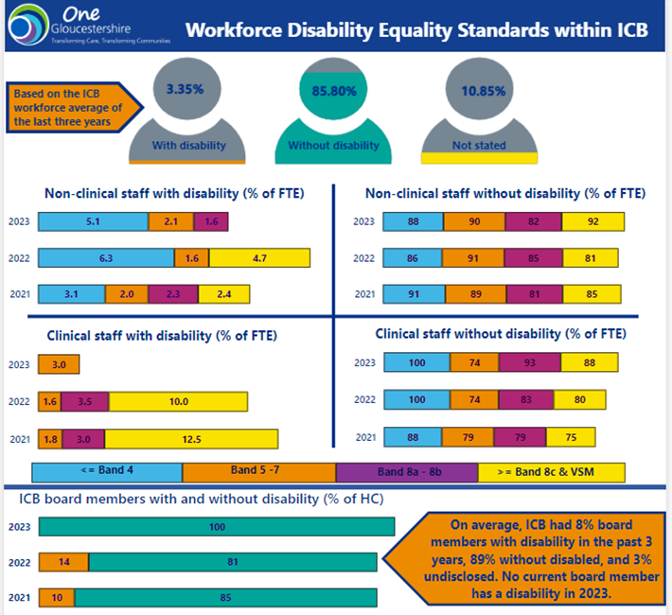

Slide 5
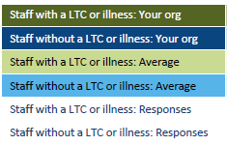
Workforce Disability Equality Standard
1. Percentage of staff experiencing harassment, bullying or abuse from patients/service users, relatives, or the public in the last 12 months:
2020 | 2021 | 2022
17.1% | 17.4% | 11.7%
12.8% | 10.1% | 7.8%
11.4% | 12.0% | 10.7%
8.7% | 8.0% | 7.3%
41 | 46 | 60
180 | 189 | 217
2. Percentage of staff experiencing harassment, bullying, or abuse from managers in the last 12 months:
2020 | 2021 | 2022
24.4% | 17.4% | 8.3%
7.7% | 3.7% | 5.6%
16.9% | 12.7% | 15.2%
8.7% | 7.2% | 7.6%
41 | 46 | 60
181 | 189 | 216

Slide 6
Workforce Disability Equality Standard
3. Percentage of staff experiencing harassment, bullying or abuse from other colleagues in the last 12 months:
2020 | 2021 | 2022
19.5% | 13.3% | 15.0%
8.3% | 5.3% | 5.1%
18.0% | 15.6% | 15.5%
9.1% | 8.1% | 8.7%
41 | 45 | 60
181 | 188 | 216
4. Percentage of staff saying that the last time they experienced harassment, bullying, or abuse at work, they or a colleague reported it:
2020 | 2021 | 2022
35.3% | 18.8% | 53.3%
62.2% | 65.3% | 64.7%
55.5% | 46.2% | 40.9%
43.2% | 46.4% | 42.2%
17 | 16 | 16
37 | 27 | 27

Slide 7
Workforce Disability Equality Standard
5. Percentage of staff who believe that their organisation provides equal opportunities for career progression or promotion:
2020 | 2021 | 2022
51.2% | 61.7% | 53.3%
62.2% | 65.3% | 64.7%
55.5% | 56.5% | 50.0%
61.5% | 63.0% | 57.6%
43 | 47 | 60
188 | 190 | 215
6. Percentage of staff who have felt pressure from their manager to come to work, despite not feeling well enough to perform their duties:
2020 | 2021 | 2022
29.2% | 25.0% | 18.9%
11.9% | 5.6% | 11.0%
19.8% | 15.0% | 15.6%
12.7% | 11.2% | 11.0%
24 | 28 | 37
59 | 54 | 82

Slide 8
Workforce Disability Equality Standard
7. Percentage of staff satisfied with the extent to which their organisation values their work:
2020 | 2021 | 2022
48.8% | 46.8% | 43.3%
51.7% | 66.8% | 65.9%
49.4% | 51.1% | 45.6%
59.8% | 58.9% | 52.8%
43 | 47 | 60
189 | 190 | 217
8. Percentage of staff with a long-lasting health condition or illness saying their employer has made an adequate adjustment(s) to enable them to carry out their work:
2022
92.3%
80.4%
26

Slide 9
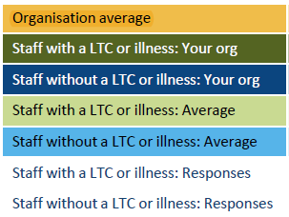
Workforce Disability Equality Standard
9. Staff engagement score (0-10):
2020 | 2021 | 2022
7.2 | 7.3 | 7.3
6.9 | 6.9 | 6.9
7.3 | 7.5 | 7.4
6.9 | 6.9 | 6.6
7.3 | 7.2 | 7.0
43 | 47 | 60
189 | 190 | 217

Slide 10
Key Actions in 2023
Programme of ED&I training all staff including at induction with a dedicated programme on Building a Culture of Conscious Inclusion programme kicked off in February 2023 to run for nine months with:
6 in person sessions (F-2-F) x half day for 140 leadership (Band 8+ and Board)
10 Module 1 virtual sessions x 1 ½ hr sessions for 200 (Band 2-7), with a month gap in between for reflection.
10 Module 2 virtual sessions x 1 ½ hr sessions for 200 (Band 2-7)
New Appraisal Paperwork and training including an ED&I objective
Managers training on health and wellbeing being delivered by Susan Doran each month, raising awareness of long term health conditions and supporting employees within the workplace including women’s health, MSK conditions etc
Continue to promote flexible working options and work life balance including the Other Leave policy and include Disability Leave in the Reasonable Adjustments policy
Produced the Health Passport and Guidance
Produce the Reasonable Adjustments Policy including Disability Leave
Produce the Policy on Zero Tolerance to Abuse to NHS staff – set up a reporting system and confidential mailbox
Produce Freedom to Speak Up Policy and ensure programme of education and publicity around FTSU increase capacity in FTSU
Continue to participate in the range of ICS ED&I programmes including Reciprocal Mentoring, Allyship Programme and Flourish Scheme

