Slide 1
Workforce Race Equality Standard (WRES)
2023 and two year trend data

Slide 2
Workforce Race Equality Standard (WRES)
WRES - introduced in 2015, following analysis of experiences of colleagues from non-white ethnicity, indicating they experienced discrimination at work in the NHS. Aims to enable organisations to analyse & close gaps between the work experiences of non-white ethnic staff compared with white colleagues.
Part of the Standard NHS Contract & the report & actions from each Trust are published annually on Trust websites.
Consists of 9 metrics, taken from ICB data & the Annual NHS Staff Survey.
NB. that the data on ethnicity is taken from ESR and from staff disclosure when completing the application form. Some staff may not disclose their ethnicity.

Slide 3
How to read the data
To note the 2021 Census found that overall, 6.9% of the population in Gloucestershire were from an ethnic minority background (excluding white minorities). This was considerably lower than the national figure of 19.0% https://www.gloucestershire.gov.uk/media/uxvcfrsp/equality-profile-2023.pdf
Questions 1-4 and question 9 within the WRES come from ESR and are reported up until 31st March for 2023 and 31st March 2022. Note that it is based on the disclosure by staff of their ethnicity when they join the CCG/ICB – NHS application form. Not all staff disclose.
This data on the infographic show the average % of white staff and BME staff who work for the ICB over those two years, which was 8.36%
The infographic shows the % of white staff and BME staff employed in clinical and non-clinical roles by a grouping of the pay bands as follows
Band 4
Bands 5-7
Bands 8a to 8b and Bands 8c+ and VSM
For non-clinical staff the majority of BME staff are employed band 7 and below; for clinical staff there is a greater % of BME staff in bands 8a and 8b, band 8c+VSM
It is also show the % of white and BME board members over those two years for example in 2023 the ICB board comprised 94% of white board members compared to 6% of BME board members.
The data shows that over the past 2 years white candidates have a greater chance of being appointed following shortlisting for a job than a BME candidate
The data shows that over the past 2 years BME staff members are more likely to enter the formal disciplinary process.
The remaining 4 questions are taken from the previous years’ staff survey – each year staff complete the survey in Oct – Nov and in March of the following year it is reported. The past three years data is shown. The 2023 staff survey results for WRES will be made available in March 2024.

Slide 4
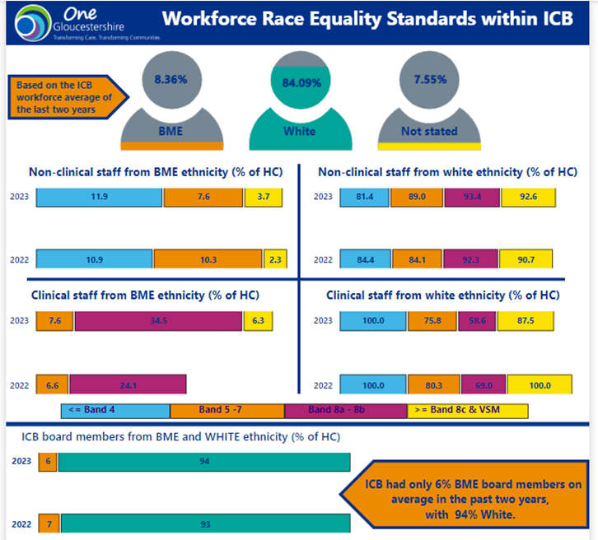

Slide 5
Workforce Race Equality Standard
1. Percentage of staff experiencing harassment, bullying, or abuse from patients/service users, relatives, or the public in the last 12 months:
2020 | 2021 | 2022
14.3% | 11.8% | 9.3%
- | 7.7% | 0.0%
7.9% | 9.7% | 7.9%
7.7% | 9.8% | 8.3%
210 | 220 | 257
9 | 13 | 17
2. Percentage of staff experiencing harassment, bullying, or abuse from staff in the last 12 months:
2020 | 2021 | 2022
17.5% | 11.8% | 10.9%
- | 7.7% | 17.6%
16.7% | 13.6% | 15.5%
24.2% | 20.6% | 20.0%
211 | 220 | 257
9 | 13 | 17

Slide 6
Workforce Race Equality Standard
3. Percentage of staff believing that the organisation provides equal opportunities for career progression or promotion:
2020 | 2021 | 2022
62.2% | 66.1% | 63.9%
- | 42.9% | 41.2%
62.7% | 65.3% | 59.3%
31.5% | 36.5% | 38.3%
217 | 221 | 255
9 | 14 | 17
4. Percentage of staff experiencing discrimination at work from manager/team leader or other colleagues in last 12 months:
2020 | 2021 | 2022
5.5% | 3.6% | 3.5%
- | 0.0% | 5.9%
3.9% | 4.7% | 4.5%
17.4% | 12.7% | 13.3%
218 | 220 | 256
9 | 14 | 17

Slide 7
Key Actions in 2023
Cultural awareness training provided to staff during 2023.
The Building a Culture of Conscious Inclusion programme commenced in February 2023 ran for nine months with:
6 in person sessions (F-2-F) x half day for 140 leadership (Band 8+ and Board)
10 Module 1 virtual sessions x 1 ½ hr sessions for 200 (Band 2-7), with a month gap in between for reflection.
10 Module 2 virtual sessions x 1 ½ hr sessions for 200 (Band 2-7)
Delivery Staff sessions - 128 colleagues have attended the virtual staff sessions. Evaluation Reports have been completed on the training and learning from these sessions
Corporate Induction includes a session on Equality, Diversity and Inclusion as well as the BAME Network
New policy on Zero Tolerance of Abuse of NHS staff in 2023 with dedicated incidence inbox and reporting
10,000 Black interns initiative commenced in 2023
ED&I objective included in the Appraisal & Objectives each member of staff to have an ED&I objective
Continue with ED&I ICS wide schemes including Reciprocal Mentoring, Allyship and Flourish
Programmes

