Slide 1
BNSSG Winter Plan
Contact keithrobertson@nhs.net & caroline.dawe@nhs.net

Slide 2
Winter Wrap Up & Lessons
2025/26 Review
A BNSSG system workshop was held 24th March in St. Monicas to assess our approach to Winter 2025-26. Key themes and actions summarised below:
Need to re-assess our escalation approach for BNSSG - COMPLETE
Increased corridor queuing and management of risk within the acute hospitals - ACKNOWLEDGED
Need to release funding with councils this summer for a system proactive approach – COMPLETE
Community and LA winter plans are required at local (place) level – ONGOING
Flexible interim funding options for complex and out of D2A patient pathways – COMPLETE
Ensure step up pathways (e.g. no pathway from P1 to P3 etc) – ONGOING
Confirm extension / flex to services now to allow for recruitment. E.g. F-ACE, CEMS to be extended now – not during autumn winter - COMPLETE
Exposure to lunch & learn with modelling teams – re: place, housing, planned care, impact on health and social care teams for UEC – COMPLETE

Slide 3
Enabling improved Community flow for 26/27
Sirona, AWP, LA feedback
1. Protect & Rebalance Capacity Between Urgent and Planned Care
Maintain strong grip on UCR 2‑hour performance while deliberately releasing limited capacity back into planned pathways, using controlled testing and trajectory‑based review.
Identify locality‑level capacity gaps and protect planned therapy time, supported by regular monitoring comparing actuals with forecasts.
2. Drive P2 Rehabilitation Flow Improvement
Strengthen system grip on P2 pathway flow, focusing on reducing avoidable delays in step‑down and improving onward care timeliness.
Apply consistent admission criteria and LOS management, as prolonged LOS remains a key constraint on acute flow.
3. SPA Telephony & Urgent Access Reliability
Clarify and update the SPA service specification ahead of winter.
4. Strengthen Data Quality, EMIS Usage & Standardisation
Complete work of deferral/breach definitions and templates to give a reliable view of unmet need and avoid rework.
5. Reduce Planned Nursing & Therapy Deferrals
BRAG is embedded, and enhanced rostering to reduce deferrals and mitigate wound‑care and planned‑nursing harm risks. Continue work to embed deferral dashboards and improve accuracy of red/amber/blue scheduling.
6. Establish D2A Pathway access for MH Patients
Ensure referral routes in deployed and available to AWP staff for step down purposes.
7. Strengthen System Flow & Escalation Preparedness
Start pathway‑specific planning (e.g., stroke/ICSS, P1/P2) earlier—by September, not mid‑winter.
(Late winter funding limited recruitment and impact this year.)
Maintain weekly updates to acutes on available capacity in high‑pressure pathways to manage expectations and flow.
8. Workforce Stability & Contingency
Earlier surge recruitment for high‑impact pathways (e.g., ICSS), avoiding December starts.
9. Clarify PBUC Funding & Operational Model for 26/27
Secure recurrent staffing funding to avoid reversion and protect 4‑hour/triage performance.
10. Enhance Demand Insight & System Coordination
Continue demand investigations (e.g., PCN variation, MSK FCP impacts) and adopt GIRFT‑linked solutions such as Community Appointment Days.
Progress system mutual‑aid discussions and FCP expansion scoping.
11. Address known bottlenecks across the pathways - including bariatric needs, delirium and dementia support, brokerage KPIs, and ‘off‑pathway’ discharges.
A coordinated, proactive approach is required, If these issues are not resolved outside of winter, the system lacks the necessary elasticity to respond effectively during periods of escalation.
12. Social care overtime for assessments
Explore this option across all 3 local authorities for potential deployment across January and December

Slide 4
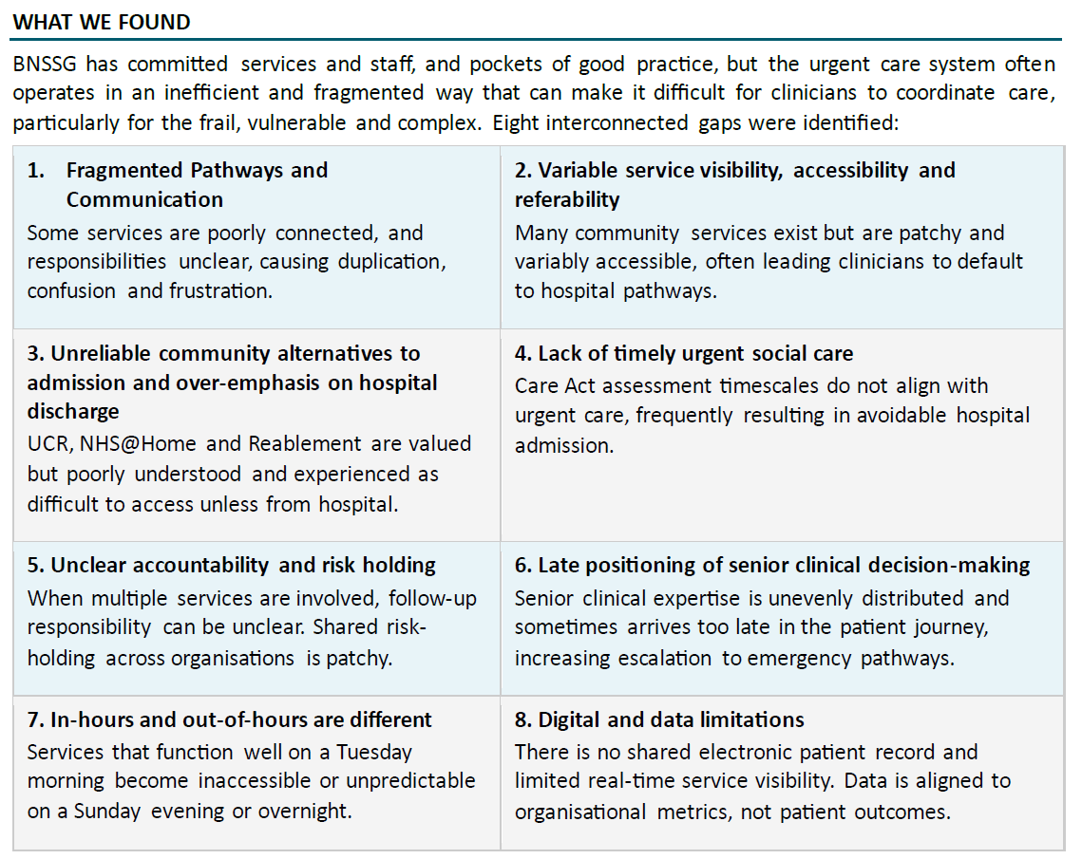
Thematic Project Findings
Work is progressing for our urgent and emergency care digital strategy. Whilst deliverables may not yet have an impact over this winter, one workstream has identified known challenges to BNSSG.

Slide 5
BNSSG Challenges / Themes:
Agreed POM priorities to mitigate
August 2026 and entering Autumn / Winter
Known challenges have emerged in our system through summer 2026, these are captured below and are to be factored into our winter delivery plans, alongside feedback from last year.
Operational agreement is to avoid buying beds in escalation where possible, and an intention to invest in core services to ensure consistent service delivery.
1. AWP Critical Incident (Summer surge in mental health)
2. High Acute & Community NCTR
3. Heatwave
1. High Use of Out of Area Mental Health Beds
5. Short term escalation actions supporting flow will end. E.g. re-ablement and staffing additionality
6. Higher patient acuity / complexity in acutes and community
2. Impact on A&E flow with limited MH bedded capacity
3. Visibility, governance and reporting challenges
4. Surge actions in pathways, community and P2 LoS and capacity, SW Ax capacity
4. Admission Avoidance
7. UCR capacity
8. ED Alternatives
5. System changes in operational delivery
8. ICBs working to updated blueprint as strategic commissioners
BCC bridging

Slide 6
BNSSG UEC Driver Diagram
AIM
PRIMARY DRIVERS
SECONDARY DRIVERS
Flexible Winter Mitigations for POM
Flu/COVID/RSV surge
1. Reduce avoidable demand
Vulnerable cohorts
F-ACE, CEMS, further admission avoidance
GP access pressures
Ambulance handovers
2. Improve front door flow
ED crowding
UCR / UTC utilisation
Community Beds
NCTR
3. Improve discharge flow
D2A delays
Safe timely urgent care through Winter 2026/27
Community LOS
Reablement
Bridging & SW top up
4. Strengthen community capacity
Bridging services
Virtual wards
UCR
MH Beds
UCR, community nursing
5. Improve mental health flow
ED Waits
Out of Area Placements
Workforce
BNSSG Intelligence and monitoring (POM dashboards) are being updated for Autumn 2026/27 to match secondary system drivers. This will be available daily, and jointly assessed weekly.
6. Improve system resilience
Governance
Intelligence
SCC Co-ordination

Slide 7

Board Assurance Statements
BNSSG ICB
 | Overall Assessment Rating: 5 - Full assurance
 |  |  |  | Rating
Section A | Governance | Plan sign off |  | 5 - Full assurance
Section B | Prevention and vulnerable cohorts | Vaccination program / vaccination campaign New UEC model of care for those at risk of presenting in crisis |  | 5 - Full assurance
 | Flow, occupancy and discharge | BFT Plans System mitigations through intermediate care |  | 4 - Substantial assurance
 | Demand, capacity, and surge management | OPEL 4, POM actions Choose Well Comms |  | 3 - Moderate assurance
 | Primary Care, NHS 111 and admission avoidance | Plans reviewed by pharmacy, onecare, primary care, severnside |  | 5 - Full assurance
 | Community Health Capacity | Incl. UCR, Virtual wards, community diagnostics, Sirona plan shared. |  | 5 - Full assurance
 | Whole System Response | Maximising out of hospital capacity |  | 5 - Full assurance
 | Leadership, operational grip and resilience | On-Call Resilience: Business Continuity Plans, Severe Weather, Industrial Action Staff Welfare Digital systems Assurance – ICB to NHSE engagement, aligned with escalation |  | 5 - Full assurance

Slide 8
Roadmap & Governance
Key Working Groups (Delivery): POM, Vaccination Working Group, Strategic Communications Group
Key dates and oversight
PEM: 13th August 2026 09:00 – 10:00 – share approach/progress/engagement
10th September 2026 09:00 – 10:00 – update items for support
ODG UEC (HCIG): 27th August 2026 11:30 – 13:00 – share approach/progress
24 September 2026 11:30 – 13:00 – for approval prior to board
FPQ 22nd September 2026 09:30 – 12:10 – DRAFt approach for approval prior to board
ICB Board: 30th September 2026 (Open Slot) times TBC
joint item with Gloucestershire and BNSSG winter plan
HOSCs Bristol (6 Oct), North Somerset (8 Oct), South Gloucestershire (13 Oct)
Winter Table-Top Exercise (NHSE SW) – 16th September

Slide 9
NHSE South West Winter Workshop – September 16th
Shared Injects:
Inject 1 - IPC/Multi-Pathogen Outbreak and Children and Young People Respiratory Surge
Inject 2 - Workforce Crisis, Sustained System Exhaustion and Industrial Action Escalation
Inject 3 - Hospital IT outage and disruption to digital systems
Inject 4 - System-Wide Discharge and Flow Failure
Inject 5 - NHS 111 Capacity and Demand Escalation, Mental Health and Primary Care Surge
Inject 6 - Mass Casualty Incident During Extreme Winter Pressure
Next Steps (September):
BNSSG and Gloucestershire dynamic flow model development using agreed system driver diagrams
Gloucestershire in person winter tabletop exercise, local stress testing
BNSSG adoption of triggers for Clinical Reference Group during escalation
Continuing oversight through winter via system executives – scheduling underway for extended UEC oversight beginning first week of January.

Slide 10
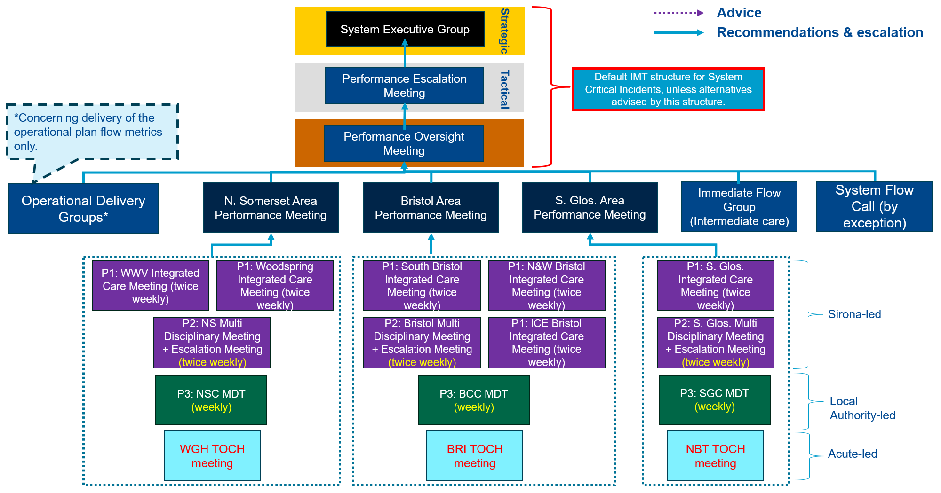
Refreshed Governance

Slide 11
Vaccination Program 2026/2027
    Good uptake of the flu vaccine in BNSSG during 2025/26 which showed an increase compared to the previous year, with over 350,900 people vaccinated in the 2025/26 programme.
    This was been achieved through a multicomponent approach. This was despite the early start (compared to previous seasons), with significant activity driven by a highly mutated variant of influenza A(H3N2), known as subclade K.
    Increases in uptake were seen in all the main cohort areas, however, a slight decrease was noted in the 65 years and over cohort, which was also seen nationally.
Uptake by age/cohort 2025/26 for BNSSG*
      Aged 65 years and older: an uptake of 80.26% at the end of the campaign, which although is slightly lower than last year, is still comparable
      Both primary and secondary school aged children showed increases in uptake, with 58.60% uptake for primary school and 49.47% uptake for secondary aged
      2- and 3-year-olds: uptake was 52.82% (March 2026), which is an increase from 49.88% the previous year (March 2025)
      Clinical Risk Groups (aged 6 months to 64 years old): uptake was slightly higher during 2025/26 (66.34%) compared to 62.74% in 2024/25
      Frontline Healthcare Workers: uptake was 55.82% during 2025/26 compared to 49.57% in the 2024/25 campaign
* Uptake figures are based on data from FDP as per 10/03/26
    Increasing uptake in the children’s cohorts will have the biggest impact on reducing the circulation of the flu virus, followed by those aged under 65 years in a clinical at-risk group.
    Furthermore, increasing the vaccination rates in Frontline Healthcare Workers may help improve staff absence and protect those they care for from influenza.
Lessons learned from the 2025/26 flu vaccination programme, including local uptake data, outreach team activity, provider feedback, and national and international evidence, are being used to inform planning to increase flu vaccination uptake in 2026/27 and beyond.
The focus will include at least maintaining flu vaccination uptake in the 65 plus years and increasing uptake and vaccination access in:
      Frontline Health and Social Care Workers
      Children – all eligible ages
      Those aged under 65 years in a clinical at-risk group
BNSSG integrated vaccination programme has been prepared through Q1 of 2026/27 with our ICB, acute, local authority and community partners. An additional Flu group has been set up to review and consider the practicalities of the plan.
Q2: Plans submitted, assurances received and roll out of programme. New One Care all aged outreach provider contract to start from 1st September 2026.
Q3/Q4: Ongoing rollout and monitoring.

Slide 12
BNSSG Vaccinations
    The BNSSG integrated vaccination programme has been established early with clear priorities summarised below. The BNSSG system wide Immunisation Strategic Oversight Board (ISOB), oversees the vaccination programme work with the Vaccination Clinical Delivery Group (VCDG) forming the operational arm. Vaccines report into the differentt governance boards within the providers and ICB.
Leadership | Provider Delivery | Communications | Communities
Regular CDG Meetings:
Ongoing Data Review:
Vaccine Priorities:
System Coordination:
Clinical Delivery Group meetings regularly review vaccination plans and coordinate system-wide actions. An additional Flu group has been put in place to support the roll out of this season's programme.
Local vaccination data is continuously analysed using tools like FDP, capacity tracker, and Immform. Fortnightly MSOA data reviews help identify areas where vaccination uptake can be maximised effectively. Relevant data to be proactively discussed with the outreach team.
Data identifies priority groups such as frontline workers and clinical risk groups for vaccination focus in 26/27.
System leads and local authorities aim to ensure coordinated flu season planning and are members of the CDG group. Providers have executive support for their plans.
Engagement:
Vaccinating Workers:
Coordinated Planning:
Monitoring Uptake:
Local trusts are collaborating to promote vaccinations for long-stay patients through clear communication and outpatient signposting. Trust maternity services also support vaccine delivery. GP Practices & pharmacies have plans to encourage uptake, with community pharmacies being able to vaccinate 2 & 3 year olds.
Providers are expected to develop strong strategies for vaccinating frontline healthcare workers to protect staff and patients alike.
Trust vaccination leads collaborate closely to ensure consistent and effective flu vaccination planning during the season.
Use of roving vaccination teams alongside a clinic offer with data monitoring enables proactive review of vaccine uptake across departments.
Providers should ensure the vaccine is accessible for all frontline staff, monitor the delivery of their programme whilst aiming to achieve an uptake of 60-65% for FHCWs.
Community Collaboration:
Flu Vaccination Agreement:
Outreach Support:
Engaging local groups strengthens messaging and supports health initiatives effectively. Activities incl. distributing leaflets, hosting talks, and running pop-up vaccination clinics to promote flu and covid vaccines.
All BNSSG practices have committed to providing flu vaccinations for 26/27, improving access for the population.
In BNSSG, the new One-Care outreach team will offer support to increase vaccine uptake in lower coverage areas through targeted community/ voluntary sector engagement or in areas where gaps are identified.
Children:
All BNSSG practices have signed up to provide covid vaccination for 26/27. Co-administration will take place where clinically appropriate and practical.
Data shows most practices have over 20% flu vaccine uptake in young children; support is offered to practices with the lowest uptake. Reminders, tools and vaccine alternatives are all offered. Opportunistic vaccinations offered at all interfaces with health. The school aged immunisation service (SAIS) continue to offer school flu vaccination visits and catch-up clinic vaccinations. Community pharmacy will be able to offer vaccinations to 2 and 3 year olds from Oct-26.
Targeted Social Media Engagement:
  Utilising platforms like TikTok and Facebook Live to engage young mothers and address concerns in real time.
Comprehensive Website Hub:
  grabajab.net provides detailed vaccination information, multilingual resources, and Easy Read materials for accessibility.
Video & Audio Case Studies:
Sharing personal stories through videos and audio to highlight real experiences and care in local hospitals and care homes
Supportive communications to providers
  Highlighting key ambitions and resources

Slide 13
Vulnerable Cohort: New UEC model. targeted prevention through 1 integrated neighbourhood intervention for rollout through Winter 2026 and beyond
Repeated crisis contact triggers one proactive, whole-person response designed to stabilise people close to home.
01
PROACTIVE ENGAGEMENT TRIADS
02
CCC SHARED FORMULATION
03
NEW INTEGRATED
I-IMR
Mental health + physical health + LA/VCSE
Comprehend • Cope • Connect
Neighbourhood intervention programme
Cross-provider identification and outreach—bringing support forward rather than waiting for another crisis.
One understanding of the crisis cycle informs one shared crisis plan and portable Passport.
Recovery, LTC self-management, medicines, behaviour change and social stabilisation around personal goals.
MY TEAM AROUND ME
MENTAL HEALTH • PHYSICAL HEALTH • PRIMARY CARE • LOCAL AUTHORITY • VCSE
Partners contribute their expertise through one formulation, one plan and one integrated programme—not separate parallel responses.
WINTER PURPOSE
Targeted prevention for a vulnerable, high-intensity-use cohort
Aim: earlier stabilisation • fewer avoidable escalations • greater use of planned care and alternatives • test impact on UEC, admissions and bed days
20
Notes:
U&E is a targeted prevention model for a clearly identifiable vulnerable cohort: people repeatedly using urgent and emergency care whose primary presentation is mental-health crisis, often alongside physical-health and social complexity. Repeated crisis contact is treated as a signal that coordinated support needs to come forward.
The innovation is the combination of three elements. First, proactive engagement triads bring mental-health, physical-health and local-authority or VCSE expertise to the person, using cross-provider intelligence to identify and engage the cohort rather than waiting for another crisis.
Second, CCC—Comprehend, Cope and Connect—creates one shared formulation of the person’s crisis cycle. It brings together triggers, physical-health needs, social pressures, strengths and the response most likely to help. That formulation informs one shared crisis plan and a portable Passport that can be used across settings.
Third, the formulation is translated into sustained support through a new integrated neighbourhood I-IMR programme. This combines mental-health recovery with physical-health and long-term-condition self-management, medicines, behaviour change, personal goals and social stabilisation.
Delivery is through a ‘my team around me’ approach. Mental health, physical health, primary care, local-authority and VCSE partners contribute their expertise through one formulation, one plan and one integrated programme—not through separate parallel referrals.
For winter planning, the intended contribution is targeted prevention: stabilising people close to home, improving planned-care engagement and use of alternatives, and testing whether the whole model reduces avoidable crisis escalation, UEC contacts, admissions and bed days. These are outcomes to test through phase one, not guaranteed immediate savings or capacity release.

Slide 14
BFT Plan: Flow Occupancy Discharge
Area | Planning assumption | Completed Actions
Demand | Emergency demand will remain at or above 2025/26 levels, with seasonal surges from respiratory illness, flu, norovirus, falls and exacerbations of long-term conditions. | Refreshed demand and capacity modelling using latest activity, conversion and admission profiles by site. Sirona working on business case for winter funding to expand Urgent Community Response capacity as an alternative to admission.
Capacity | Non-Elective bed capacity will remain constrained without sustained reductions in length of stay and delayed discharges. | Updated bed models for Southmead, City Centre and Weston at agreed occupancy assumptions. Refreshed Flow, Surge and Escalation policies for all sites
Discharge | No Criteria to Reside and delayed transfers remain material drivers of bed pressure. | BFT commissioning 36 intermediate care beds at The Burren for 12 months. Start date likely to be early November. Intermediate Care Programme working on other actions include a home-based pilot in North Somerset and a business case for emergency admission avoidance beds for end-of-life patients at St Peter’s Hospice.
Workforce | Vacancies, sickness, residual industrial action risk and winter illness will affect resilience. | Monitored rota resilience, including additional staffing funded for winter on all sites, bank/agency controls, vaccination plan and wellbeing offer. January to mid-February 2027, workforce availability will be supported through temporary deferral of non-essential training where appropriate. Existing committed UWE course activity will be maintained where reasonably practicable, while study leave will remain subject to operational requirements.
Infection prevention | Flu, Covid, norovirus and other respiratory infections will drive isolation demand and bed closures. | Confirmed testing, cohorting, PPE, fit testing and seven-day IPC cover arrangements.
Finance | Winter schemes must be prioritised against safety, statutory delivery, benefit and affordability. | Allocated winter reserve, recurrent/non-recurrent funding and benefits tracking.

Slide 15
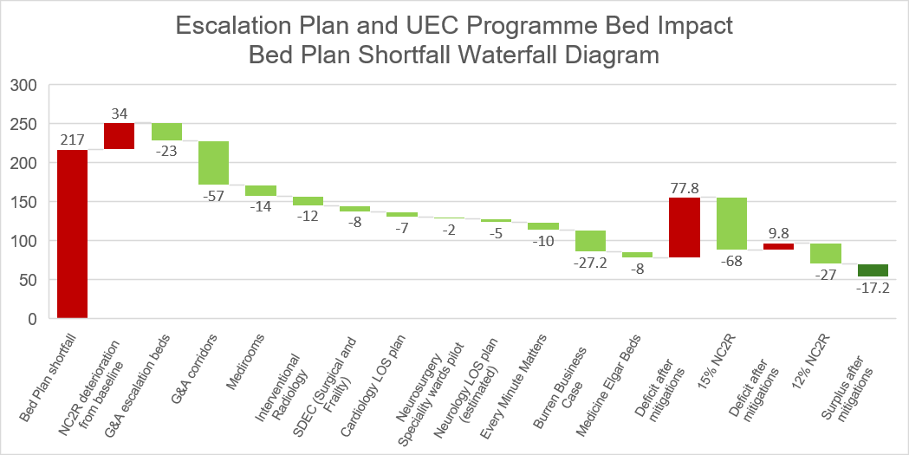
Acute Mitigations

Slide 16
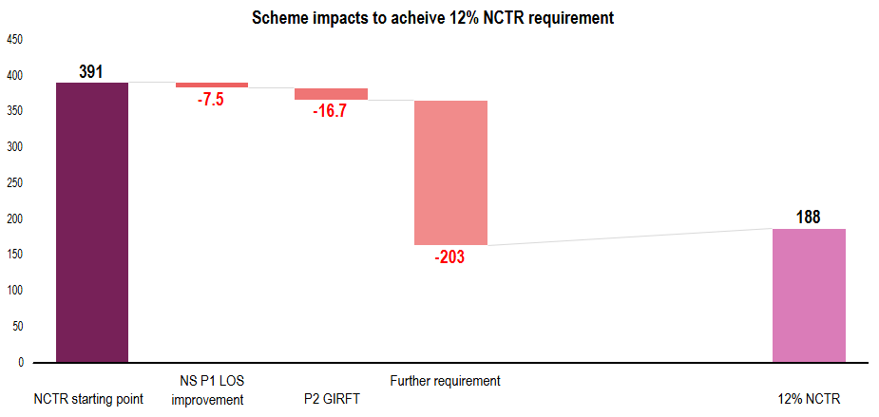
Intermediate Care Programme
    System mitigations are chiefly sought through the work of the Intermediate Care & Prevention Programme which is leading on alternatives to admission as well as discharge facilitation schemes.
    The program is tracking progress against closing the gap between acute NCTR levels and the system target of 12% by year end. Summer 2026 has seen a deterioration in the acute NCTR position resulting in the starting point for BFT NCTR being c440 (September-2026), and not 391.
Immediate Flow Schemes | Type | Status
North Somerset HBIC test of change (step down) | Step Down – Home | Live on 20 Jul-26
P2 GIRFT | Step Down –Beds | Live
The Burren | Step Down – Beds | Decision needed (investment)
Elgar House | Step Down - Beds | Decision needed (investment)
End of Life admission avoidance | Step Up – Home | In development
GP support for frequent hospital admissions | Step Up – Home | In development
South Glos HBIC test of change (step up) | Step Up - Home | In development
HBIC Menu of Options (P1) | Step Up & Down: Home | In development
North Somerset Sirona ASC Interface (P2/P3) | Step Down - Beds | In development
Bristol P3 delays (self funders, delirium, brokerage) | Step Down - Beds | In development
CHC interfaces and delays | Step Down: Home & Beds | In development
Caafi Health pull model (Southmead) | Step Down – Home | In development
UEC ODG schemes: X-Ray Car, Mental Health ED | Step Up - Home | In development
11 schemes are being developed at pace which will help to close the gap. Some schemes (The Burren & Elgar House) can be quantified and implemented immediately with system approval and investment.
Assumes overall acute demand growth of 3%

Slide 17
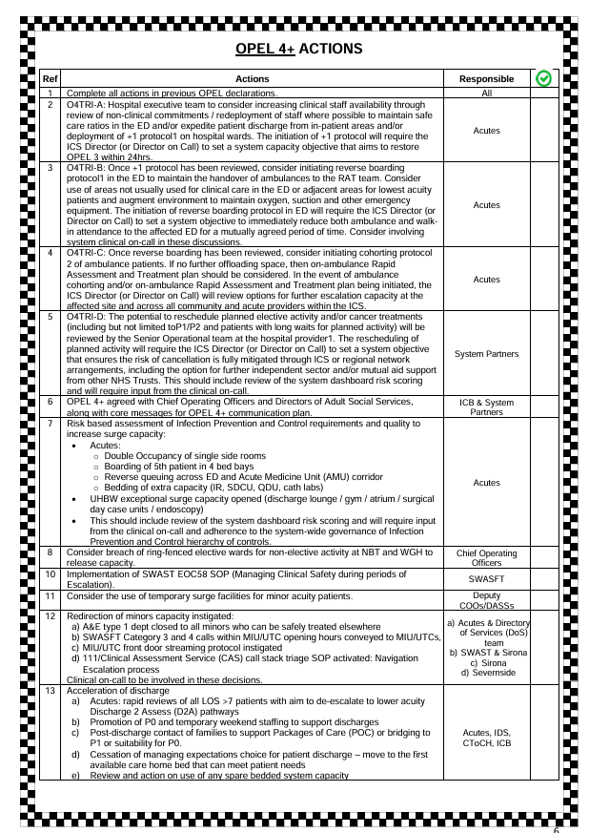
4 Demand, Capacity, Surge Management
Surge Plans, surge capacity which cannot be managed directly or requires alternative capacity assessment/provision will be mobilised via POM and PEM (scheduled weekly).
The BNSSG OPEL 4 action cards and processes have been refreshed during summer 2026. Our providers and system are practiced in stepping up capacity in the following areas:
Mental Health OOA (out of area) beds ✓
Timely Handover Process (THP) – acute A&E corridors ✓
Other acute escalation space✓
4 beds at Sirona SBCH / dynamic team allocation ✓
Other system spot purchase beds ✓
Bridging ✓ (mitigations underway through intermediate care)
SW capacity ✓ (through PEM)
Heatwave action cards refined on admission /attendance avoidance, planned for review in preparation for updating cold weather plans
(CEMS / REACT / F-ACE / P-ACE) ✓

Slide 18
Winter communications 2026/27
Aim: Support system resilience and improve health outcomes in line with cluster Winter Plan priorities by helping vulnerable groups avoid winter-related illnesses likely to lead to hospital admissions; and helping those who need care to access the right service for their needs.
Objectives
Support flu and Covid-19 vaccine uptake | 2. Help people access right care | 3. Reduce avoidable winter illness | 4. Support infection prevention and control | 5. Support discharge and flow | 6. System readiness and resilience
Eligible groups. New priority cohorts (homeless). System staff. Care homes. | All 16+, with focus on groups most likely to use ED for minor conditions. | Older adults. People with long-term health conditions and co-morbidities. | All adults. Health and social care staff. | Families and carers of hospital inpatients. | All adults. System stakeholders.
‘Stay Strong Get Vaccinated’, protect yourself and others by taking up vaccinations when offered. | ‘Choosewell’, get the right care for your needs (focus on self-care, pharmacy, PBUC, NHS 111) | ‘Staywell’, take simple steps to avoid winter illness (eg stay active, stay warm). Look out for others. | ‘Beat winter bugs’: help stop bugs spreading; handwashing, ventilation, ‘catch it/bin it/kill it'. | ‘When will I go home?’: talk to ward staff about how you can help loved ones return home promptly. | ‘Ready for winter’ PR on system readiness. Tiered escalation messaging.
Key
audiences
Key messages

Slide 19

Approach
Co-ordinated, cluster-wide approach overseen by cluster winter comms group, with shared resources and activity
Insight-led, using BI to identify priority audiences and target activity
Amplifying national/regional campaigns, for consistency across cluster and to minimise duplication
Prioritising local people and voices, eg ‘Staywell’ (right) tailored to local priorities and featuring local people
Deliverables/tactics to include:
Media and PR stories aligned to campaign strands
Rolling organic social media feat. local voices
Digital (system minisites for vaccs, staywell, choosewell)
Advertising bursts (targeted social media and outdoor)
Partnership, incl. campaign toolkits
Stakeholder briefing and updates
Staff communications and updates
Community engagement, working with local VCSE partners

Slide 20
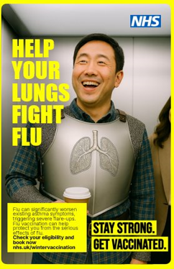

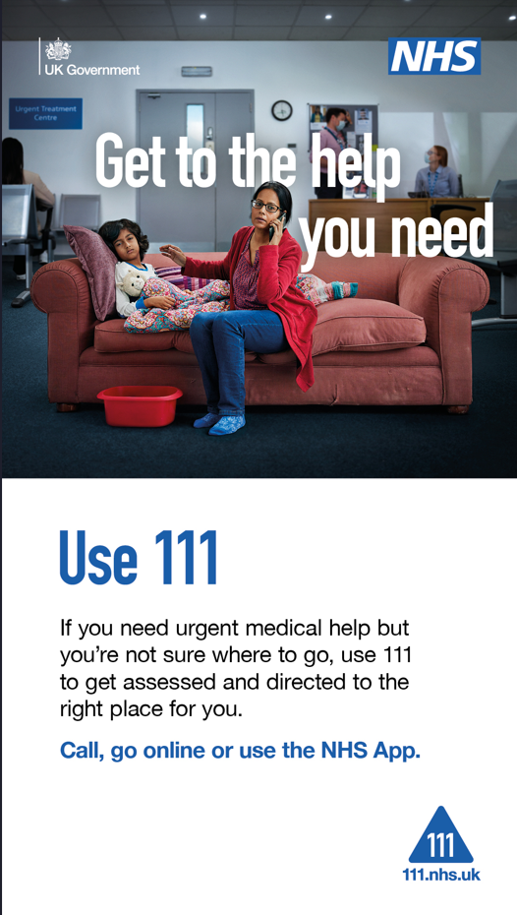



Creative

Slide 21

Winter Communications 2026/27 Indicative Timeline
Aug
Sept
Oct
Nov
Dec
Jan
Feb
All-msg
PR
Door drop
Vaccs
Internal (staff)
Advertising
PR
Owned / earned
Staywell
Owned / earned / partnership
Advertising
Choosewell
Owned / earned
PR
IPC
Owned / earned
Advertising
Discharge
Owned /earned (esp. on-site)
*Timeline to be aligned to national and regional NHS campaign plans once confirmed.
21

Slide 22
5. Primary Care
ARI LES
Acue Respiratory Infection Local Enhance Service. The ARI LES was agreed at the LES steering group including addition of a 'surge' / top up arrangement to this which would be activated during surge in the same way as when One Care managed ARI.
GP OPEL Framework
A new BNSSG GP OPEL framework is in place ready for Winter 26/27. Launch is now pending, as we progress the transition of GP aggregate data into the SCC tool.
Demand & Capacity Primary Care
We are gathering data about the growth of waiting lists for routine appointments, which are understood to be a consequence of some contractual changes last year. There are some winter risks associated as these lists are likely to grow at a faster rate through winter as practices in OPEL 4 manage the balance of routine and urgent slots to prioritise on the day urgent.
Demand & Capacity – Severnside (111)
Pharmacy
SevernSide Integrated Urgent Care Services provide our out of hour service including:- 24/7 Clinical Assessment Service-OOH face to face appointments at Treatment Centres across BNSSG-OOH Home Visits when appropriate-24/7 signposting for people to the most appropriate service to meet their needs
BNSSG remains a leading system nationally in regards to pharmacy first – referrals to community pharmacy for minor illness from 111, GP practices and walk ins for specific conditions.. Demand is regularly assessed; work is ongoing to increase contraception prescribing to free up GP capacity. BNSSG have developed local PGDS (patient group directions for direct prescribing) to further release GP practice capacity. Regular meetings with our out of hours provider (PPG) and the DOS team are undertaken to improve referral from NHS111 telephony to community pharmacy. Independent prescribing forms part of the contract from Autumn 26. DMS (discharge medicine summary) is being looked at in conjunction with our Acute partners.

Slide 23
Admission / Attendance Avoidance Services
Updated the service opening for many of our services which make up our healthcare front door. Service times have been extended where beneficial over winter, and in some cases, now covers 5 days, where before partial weekly cover was previously commissioned.
REACT – The Rapid Emergency Assessment Care Team works in the emergency departments at the Bristol Royal Infirmary (BRI) and Southmead Hospital supporting people over the age of 18, with the aim of preventing unnecessary admissions to hospital and helping people return home sooner. Weekend and evening cover is being assessed over winter.
CEMS – The Community Emergency Medicine Service (CEMS), places a senior Emergency Medicine clinician on a rapid response vehicle alongside a SWAST paramedic. The service focusses on patients who would otherwise be admitted to hospital and enables more people to be treated in the community. This service is now commissioned 5 days / week ahead of winter 2026. This secures the rota and ensures service stability for the EDs and CEMS. Step up weekends can be considered
UCR – The Urgent Community Response offers a same day multi-disciplinary response, incorporating a comprehensive holistic assessment supporting people within the domiciliary setting who are at risk of an unplanned, hospital admission or ED attendance. Funding for extended service provision now confirmed and to be mobilised for Winter.
F-ACE & P-ACE – Frailty-ACE (Assessment and Coordination for Emergency and urgent care) aims to support frail patients who would otherwise be admitted or conveyed to hospital, recognising the balance of risks and benefits associated with admission are often more finely balanced, or even unfavourable, for frail people. This has been expanded to cover bank holidays, evenings and weekends during January and the end of December.
NHS@Home – step up (admission avoidance) activity to be considered, maximising capacity
System CAS – 111 Clinical Assessment Service, Senior clinical advice for patients who have a 999 or ED disposition through the initial health advisors to prevent conveyances or attendance at A&E depts.

Slide 24
6 Community Health Capacity, Sirona Winter Planning Priorities
A thorough community winter plan has detailed service provision, predicted activity and winter mitigations for each service.
Maintaining safe and effective delivery of core community services, with explicit prioritisation where demand exceeds available capacity.
Supporting BNSSG urgent and emergency care flow by strengthening community alternatives to hospital attendance and admission.
Sustaining Urgent Community Response (UCR) performance, a continued focus on maintaining at least 70% 2-hour response performance.
Optimising NHS@Home capacity, including the planned capacity expansion from 101 to 117 modelled beds for November 2026, and improved integration with step-up and step-down pathways.
Supporting discharge and intermediate care flow, including Pathway 1, Pathway 2 and Home Based Intermediate Care improvement work.
Providing Therapy input for the additional capacity at the Burren Nursing Home
Strengthening operational grip through daily oversight, escalation, OPEL reporting and clearer action cards.
Maintaining vaccination, IPC, EPRR and adverse weather readiness as core elements of winter resilience.
Co-ordinate a system wide perfect fortnight ahead of predicted December / January surge pressures, in line with predicted activity surge

Slide 25
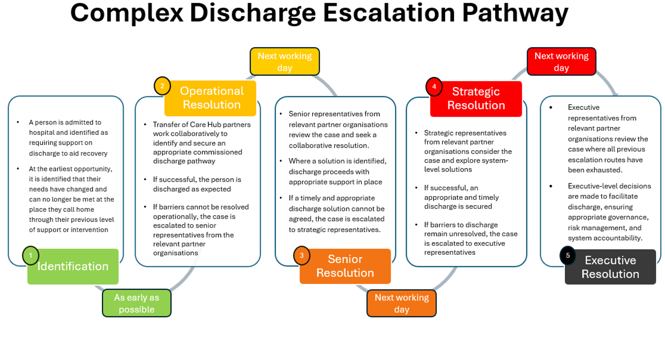
New Escalation Pathway for Complex Discharge
Through summer 2026, a review of the previous P3+ SOP, has enabled a refreshed approach. The revised SOP establishes clear system-wide escalation expectations for all partners when securing discharge solutions for individuals whose needs cannot be met through existing commissioned pathways.
The document is supported by additional appendices setting out each organisation's internal escalation process. This provides clarity on the respective responsibilities of each partner in supporting timely and appropriate discharges for people using our services.
The process is designed to support discharges across the wider system, including community beds and Pathway 1 provision.

Slide 26
7 Leadership, Operational Grip & Resilience
BNSSG UEC governance has been updated ahead of Autumn 2026/27. Our Gold and Silver system meetings (POM and PEM) have had refreshed their terms of reference.
BNSSG and Gloucestershire ICB arrangements now ensures aligned strategic and tactical on-call cover across our cluster footprint. On-call cover has been published till the end of January.
Operational grip for BNSSG has been historically led through daily system calls chaired by the ICB. Summer and Autumn 2026/27 has allowed us to refresh this approach. With improved digital dashboards, giving us increased service visibility, and day to day service flexibility discussed directly between providers. This refreshed approach has released operational leadership time. ICB or partners can stand up a call (by exception) using the following triggers:
Any organisation declaring Business Continuity Incident (BCI) and requesting a system call
Any organisation declaring a Critical Incident (CI)
System Level at OPEL 4 for >48hrs and decision for call confirmed via POM.
Any exceptional issue requiring a system response such as industrial action, mutual aid requests etc

Slide 27
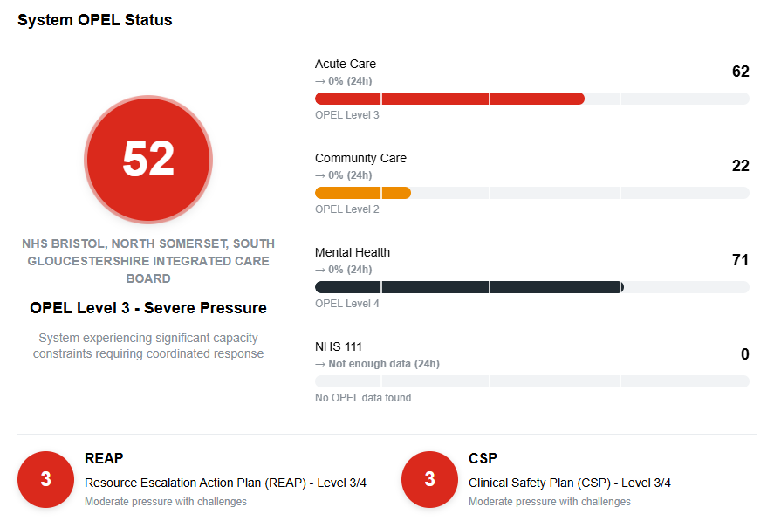
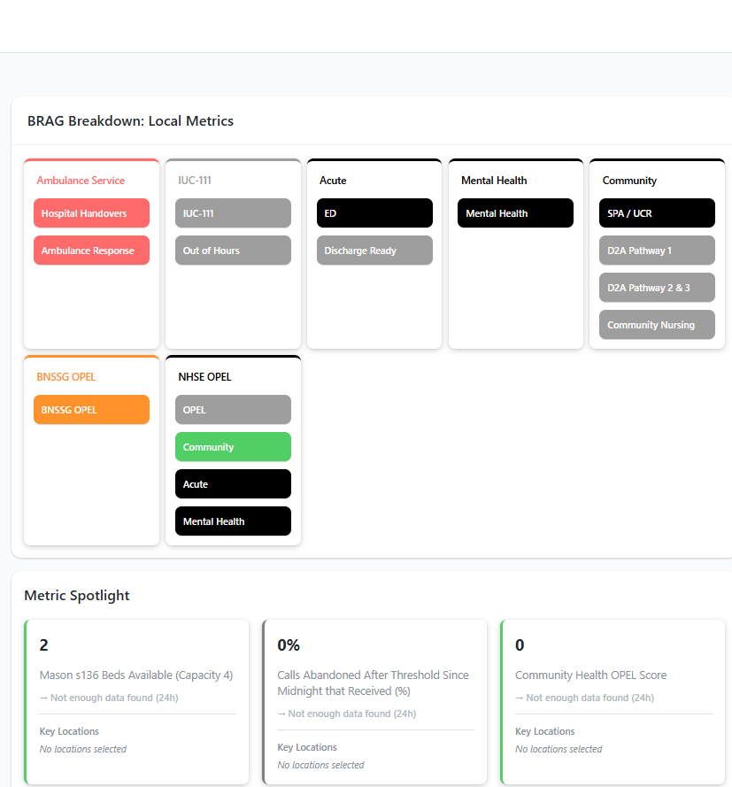
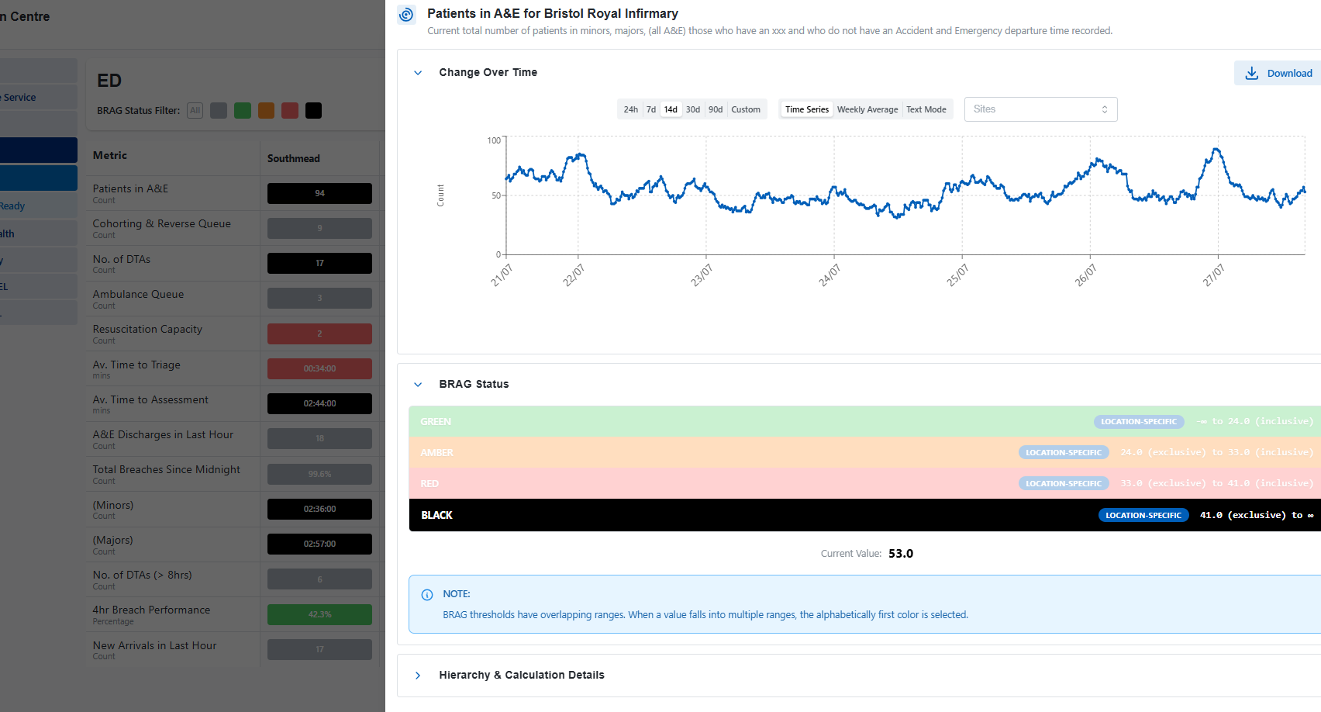
FDP (SCC) Dashboard – Rollout Sept-26
Link: System Coordination Centre
In conjunction with our BNSSG intelligence centre, a UEC system dashboard replacement has been deployed through Summer 2026. This provides live and near real time visibility of escalation statuses, system flow pressures across all healthcare partners.

Slide 28
8 System Co-ordination Centre (SCC)
The system co-ordination centre (alongside EPRR) will remain the single point of contact for UEC flow resolution through winter 2026. The ICB continues to ensure adherence to the NHSE SCC standards (here).
Updates to the co-ordination of this ahead of winter will include:
Streamlining SCC administrative arrangements within the BNSSG and Gloucestershire cluster
Visibility in our singular UEC dashboards of operational delivery networks impacting our system and partners -
  Incl. Maternity, Paediatrics, Critical Care – and associated escalation frameworks
Continuation of our predictive modelling analytics embedded in our operational dashboards
Scoping digital solutions for deploying system actions

