Slide 1

Gloucestershire PPG Network
January 2017
Sustainability and Transformation Plan

Slide 2

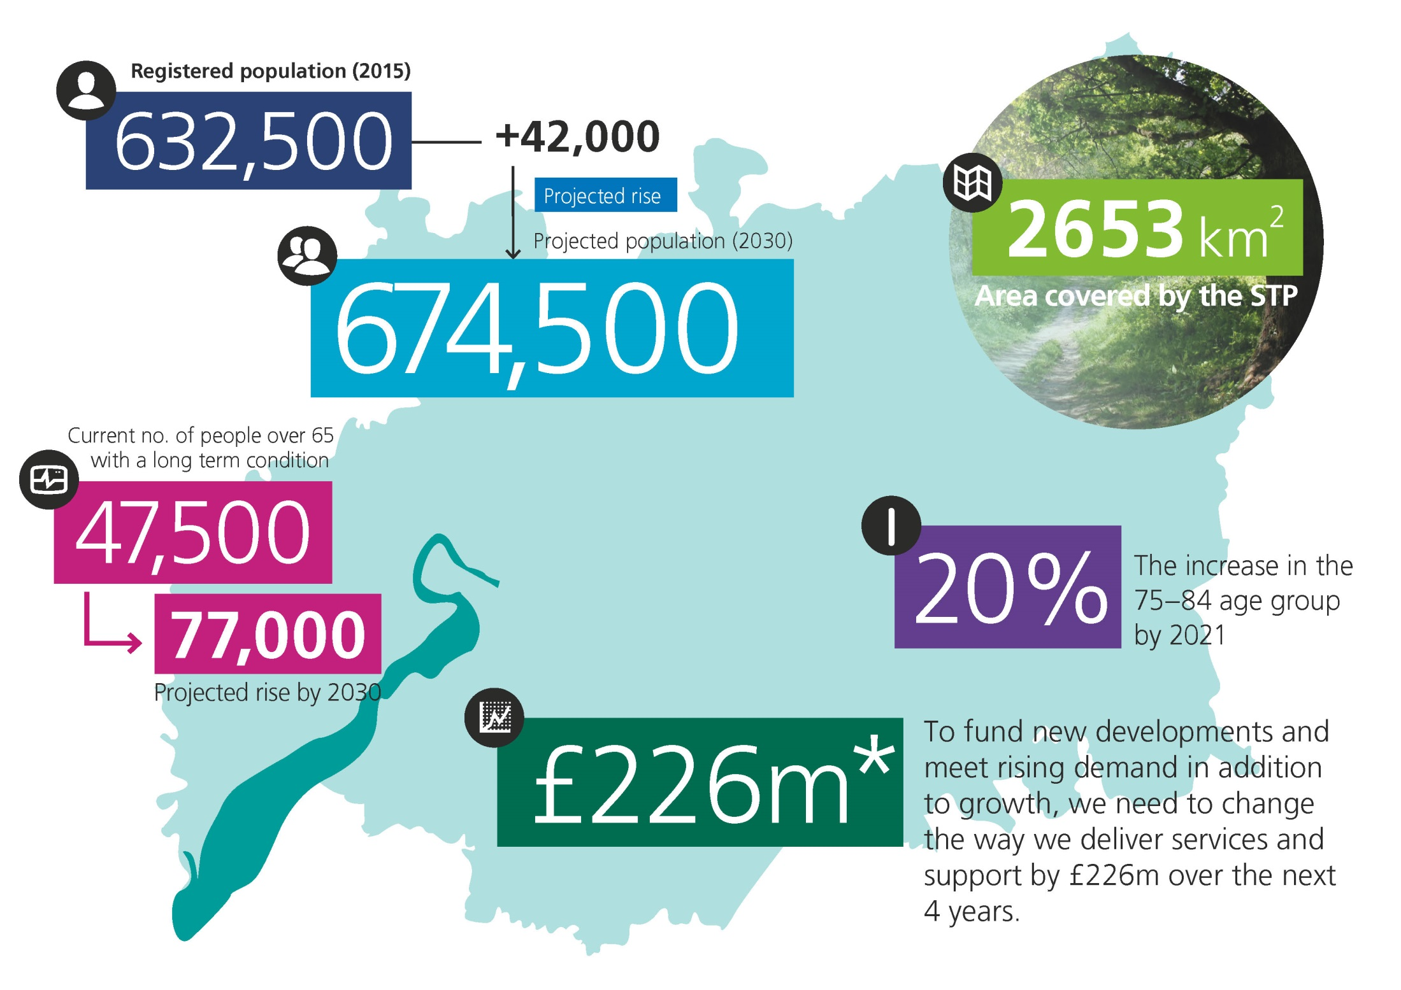
Background:
Notes:
** To meet the needs of local people, we think we need to spend more money on priority areas like GP services and mental health and fund vital new drugs and treat
Background:
Our ageing population, changing patterns of disease and rising patient expectations means that changes will be required to the way in which care is delivered in our county
JUYC told us more people want to be more involved in their own health, and when they are, decisions are better, health and health outcomes improve, and resources are allocated more efficiently

Slide 3
Our Shared Vision:
“To improve health and wellbeing, we believe that by all working better together - in a more joined up way - and using the strengths of individuals, carers and local communities, we will transform the quality of care and support we provide to all local people’”.
Our STP builds on the strategic commitments set out in: Joining Up Your Care and the three gaps in the NHS Five Year Forward View
We have worked together to further develop our shared work programme, financial savings plan and objectives
Our shared transformation work programme is focussed on ensuring we will have a sustainable health and care system for Gloucestershire – for now and for the future

Slide 4
Financial Challenge:
We all recognise the financial challenge is significant over the next four year planning horizon.
Our plan identifies opportunities to make savings across our system, split across our priority areas
The system is committed to owning and resolving the issues we have identified to meet the significant challenge and we are working together to agree a clear plan
There will inherently be additional costs in delivering change in terms of supporting service change and capacity needed to design and deliver our STP programme at scale and pace. We will need to identify services of funding to pump prime change in the next 3 years.

Slide 5
Enabling Active Communities
Enabling Active Communities
Radical Self Care and Prevention Plan
Clinical Programme Approach
Reducing Clinical Variation
Choosing Wisely Medicines Optimisation
Diagnostics Review
One Place, One Budget, One System
Primary Care
Reset Pathways for Dementia and Respiratory
System Enablers
Place Based Commissioning
Reset Urgent care and 30,000 community Model
Joint IT Strategy
Joint Estates Strategy
Workforce
Deliver the Mental Health FYFV
Enabling Active Communities - We will develop a new sense of personal responsibility and improved independence for health, building community capacity and ensure we make it easier for voluntary and community agencies to work in partnership with us. We will use this approach to deliver a radical Self Care and Prevention plan to close the Health and Wellbeing gap in Gloucestershire
Including:
Work-place Wellbeing Charter
Whole System approach to Obesity
Diabetes Prevention Programme – Diabetes NHSE Digital Test Bed
Closer working with system partners and VCSE, supported by Devolution
System to support person-led care and personalised care planning i.e. IPC
Programme Leaders: Margaret Wilcox, Linda Uren and Mary Hutton
Yr 1
Continue to deliver Social Prescribing with system partners
Yr 1
Develop and initiate delivery of Prevention and Self Care plan
Yr 2
Support Prevention and Self Care plan with Social Movement public campaign
Yr 3-5
Learning from Yr 1 & 2 to set further priorities
Self-Care and Prevention plan delivered by Enabling Active Communities approach
Notes:
Recent News:
All our cultural commissioning pilots are now underway, and findings from the Programme were published in the national report ‘The Art of Commissioning’ (April 2016)
Social prescribing is now live across Gloucestershire, next steps are to streamline current commissioning around community connectors, social prescribing and advice and signposting
Project work is starting to streamline access to online information for the public on health and wellbeing support and community services

Slide 6
Clinical Programme Approach
Enabling Active Communities
Radical Self Care and Prevention Plan
Clinical Programme Approach
Reducing Clinical Variation
Choosing Wisely Medicines Optimisation
Diagnostics Review
One Place, One Budget, One System
Primary Care
Reset Pathways for Dementia and Respiratory
System Enablers
Place Based Commissioning
Reset Urgent care and 30,000 community Model
Joint IT Strategy
Joint Estates Strategy
Workforce
Deliver the Mental Health FYFV
Clinical Programme Approach - We will work together to redesign pathways of care, building on our success with Cancer, Eye Health and Musculoskeletal redesign, challenging each organisation to remove barriers to pathway delivery. Our first year will focus on delivery of new pathways for Respiratory and Dementia to help us close the Care and Quality Gap.
Including:
Reorganising care pathways and delivery systems to deliver right care, in the right place, at the right time.
Additional focus on ‘Designing for Delivery’
Ensure integrated approaches across our commissioning boundaries i.e. Specialised Commissioning
Progress the Collaborative Commissioning Processes (NHSE) and plans for delegated commissioning.
Programme Leader: Deborah Lee
Yr 1
Complete Implementation of Cancer, Eye Health and MSK Clinical Programmes and share learning
Yr 1
Deliver new pathways for Respiratory and Dementia Clinical Programmes
Yr 2
Deliver new pathways for Circulatory and Diabetes Clinical Programmes
Yr 3-5
Further programme priorites based on progress and Right Care updates
Self-Care and Prevention plan delivered by Enabling Active Communities approach
Notes:
Recent News:
First Respiratory workshop held on 22nd July, Respiratory ‘Quick wins’ identified and underway
Dementia work plan in development using the Clinical Programme Approach
Cancer CPG received an Award for Early Diagnosis
Macmillan have invested substantially within Gloucestershire, supporting our ‘living with and beyond’ programme
Glaucoma Repeat Readings and Enhanced Case Finding service is now live in 21 practices, with 58 practices now registered in total

Slide 7
Reducing Clinical Variation
Enabling Active Communities
Radical Self Care and Prevention Plan
Clinical Programme Approach
Reducing Clinical Variation
Choosing Wisely Medicines Optimisation
Diagnostics Review
One Place, One Budget, One System
Primary Care
Reset Pathways for Dementia and Respiratory
System Enablers
Place Based Commissioning
Reset Urgent care and 30,000 community Model
Joint IT Strategy
Joint Estates Strategy
Workforce
Deliver the Mental Health FYFV
Reducing Clinical Variation - We will elevate key issues of clinical variation to the system level and have a new joined up conversation with the public around some of the harder priority decisions we will need to make. Our first priority will deliver a 'Choosing Wisely for Gloucestershire' Medicines Optimisation and undertake a Diagnostics Review. This programme will also set the dial for our system to close the Care and Quality Gap.
Including:
Managing Clinical Variation in Primary Care
New innovative medicines optimisation approach for patients living with pain
Strengthening Clinical Pharmacist support to our local GP practices.
Programme Leaders: Paul Jennings
Yr 1
Develop Medicines Optimisation Programme supported by Choosing Wisely conversation with the public
Yr 1
Deliver follow up project and undertake diagnostics review of county in particular support of urgent care strategy.
Yr 2
Implement findings of diagnostic review and next stage of Choosing Wisely programme.
Yr 3-5
Learning from Yr 1 & 2 to set delivery for years 3-5.
Clinical variation at system level, to address key priority setting decisions together
Notes:
Recent News:
Follow ups programme now live to deliver substantial change in follow ups provided in new ways, including patient initiated follow ups, telephone based follow ups, and new community based services such as community optometry based cataract follow up and our new living with and beyond cancer service
Joined up approach across our system to Medicines Optimisation being agreed to deliver substantial savings programme, and reduce waste and harm
Diagnostics review to be commissioned

Slide 8
One Place, One Budget, One System
Enabling Active Communities
Radical Self Care and Prevention Plan
Clinical Programme Approach
Reducing Clinical Variation
Choosing Wisely Medicines Optimisation
Diagnostics Review
One Place, One Budget, One System
Primary Care
Reset Pathways for Dementia and Respiratory
System Enablers
Place Based Commissioning
Reset Urgent care and 30,000 community Model
Joint Estates Strategy
Joint IT Strategy
Workforce
Deliver the Mental Health FYFV
One Place, One Budget, One System - we will take a place based approach to our resources and deliver best value for every Gloucestershire pound. Our first priority will be to redesign our Urgent Care system and deliver our 30,000 community model. We will take a whole system approach to beds, money and workforce to reset urgent and community care to deliver efficiently and effectively. This will ensure we close the Finance and Efficiency Gap, and move us towards delivery of a new care model for Gloucestershire.
Including:
7 day services across our urgent care system by 2021
Integral part of the Severn Urgent and Emergency Care Network Plan
Locality led New Models of Care pilots to ‘test and learn’ (15 collaborative clusters established)
Design and implement models of care based upon the needs of local population across organisational boundaries.
Programme Leaders: Mary Hutton and Paul Jennings
Yr 1
Deliver pilots to reset the dial for Urgent Care system and 30,000 place based Community Teams
Yr 1
Pool urgent care resources in shadow form to take 'place based' Commissioning Approach and agree county bed model
Yr 2
Implement urgent and community care model at wider scale based on Yr 1 learning, reset county beds
Yr 3-5
Learning from Yr 1 & 2 to set a new care model, urgent & responsive care resources pooled on place basis
Self-Care and Prevention plan delivered by Enabling Active Communities approach
Notes:
Recent News:
15 collaborative clusters have been established throughout Gloucestershire, with only 2/81 practices not included at this stage
A service model is being developed to deliver integrated primary and community based urgent care services seven days per week across Gloucestershire
South Cotswold Community Frailty Initiative has been well received during engagement and further PPI events will continue in Autumn following recruitment of a new Frailty team

Slide 9
System Enablers
Enabling Active Communities
Radical Self Care and Prevention Plan
Clinical Programme Approach
Reducing Clinical Variation
Choosing Wisely Medicines Optimisation
Diagnostics Review
One Place, One Budget, One System
Primary Care
Reset Pathways for Dementia and Respiratory
System Enablers
Place Based Commissioning
Reset Urgent care and 30,000 community Model
Joint Estates Strategy
Joint IT Strategy
Workforce & OD
Deliver the Mental Health FYFV
We will work together to deliver a range of System Enablers as follows:
Workforce and Organisational Development
  Programme Leader: Shaun Clee
Quality Academy
  Programme Leaders: Deborah Lee and Shaun Clee
STP Programme Development and Governance Models
  Programme Leaders: Mary Hutton and Paul Jennings
Joint IT Strategy
  Programme Leader: Shaun Clee
Primary Care Strategy
  Programme Leader: Andy Seymour
Joint Estates Strategy
  Programme Leader: Pete Bungard
:
Notes:
Workforce
Established OD and Workforce Strategy Group - developed work programme that focuses on Culture, Capability and Capacity.
Investing in skills and leadership to support people to work in new ways.
Agree a model for distributed leadership which supports people to lead our 12 STP priorities across the system.
Quality Academy
A system wide approach to quality and service improvement.
AHSN & QSIR support to ensure application of latest thinking
Programme Development & Governance
Shared Communications and Engagement Plan, Finance and Resource Plan and performance reporting.
Development of Memorandum of Understanding (MOU) across our priorities including Kings Fund 10 Overarching Principles for integration.
Joint IT Strategy
Local Digital Roadmap Footprint developed for Gloucestershire aligned to our STP boundary.
Joining Up Your Information (JUYI)
Digitally enabling people to support our Self Care Agenda.
Support staff in the adoption of new technologies
Working towards a paper free NHS by 2020.
Primary Care Strategy
Developing a resilient primary care sector that supports joined up care closer to home.
Support to primary care workforce and infrastructure, offer increased access for patients, how primary care will work more collaboratively at scale.
Joint Estates Strategy
One Gloucestershire Estates Group established
Utilising opportunities to better utilise public sector assets across the wider estate within the county – develop a wider strategy across the Gloucestershire estate.
Primary Care Infrastructure Plan 2016/2021 developed – key priorities for developing new models of care.

Slide 10
Get Involved
Ways to have your say:
Public Drop Ins
Feedback Form
Online Survey http://www.gloucestershireccg.nhs.uk/gloucestershire-stp/

Slide 11



General Practice Forward View
Helen Goodey
27 JANUARY 2017
#GlosGPFV
Notes:
Thank you all for coming to this PPG network meeting
I am providing an update on the work taking place for the General Practice Forward View in Gloucestershire - CCG work.

Slide 12



Gloucestershire CCG Approach
Driving implementation
Primary Care Strategy – Patient Version
Full funding to practices, including making CCG investment recurrent
Supporting vulnerable practices
16 Clusters
7 GP Provider Leads
#GlosGPFV
Notes:
General Practice Forward View – National and Local implementation
In Gloucestershire we’re ensuring Primary Care receives the full funding, with a top up that the General Practice Forward View sets out.
Our recently published Primary Care Strategy
the patient version is on tables
demonstrates Glos CCG commitment to Primary Care
a basis of New Models of Care.
Formation of 16 clusters across the county
working together to design and deliver their schemes,
such as clinical pharmacists and mental health workers in general practice,
health visiting services for frail patients.
Supporting practices through practice funding, resource and practical support from the Localities and Primary Care team.
Invested in 7 GP Provider Leads representing localities –
Sit on the newly established New Models of Care Board,
Fits within the overall Gloucestershire STP – Becky has just spoken about

Slide 13
Gloucestershire STP: A succinct summary
Challenges:
Growing and increasingly elderly population
Increasing demand
Financial pressures
Recruiting and retaining staff
#GlosGPFV
Notes:
These are challenges across our healthcare system – including primary care and our other services
Talk about these challenges from primary care strategy
Growing and increasingly elderly population – people living longer, accessing more care
Increasing demand – growing
Financial pressures – challenges on finance and savings
Recruiting and retaining staff – workforce challenges/high quality staff/reducing turnover/attraction

Slide 14
Gloucestershire STP: A succinct summary
Ambitions:
People and Place based care, centred on GP practices at the core
Enabling Active Communities
Reduce variation
Improved urgent care provision
#GlosGPFV
Notes:
Ambitions…
Working together collaboratively as the foundation of working with provider partners, in groups of circa 30,000+,
deliver care centred on the needs of practice populations.
Plan to invest in placing a greater emphasis on self-care and prevention including social prescribing initiative which has been beneficial for patients.
In reducing variation, we will be addressing areas such as:
- medication waste
- looking at how we can deliver some services more efficiently.
Urgent care is a priority for our system
improve this for patients to remove the confusion and duplication of services
make more diagnostics and specialists available in the community.

Slide 15
Gloucestershire STP: Our Primary Care Vision
So patients can stay well for longer and receive joined-up out of hospital care wherever possible, we need to have a sustainable, safe and high-quality primary care service, provided in modern premises that are fit for the future.
#GlosGPFV
Notes:
This is the vision developed for our Primary Care Strategy – started at the Primary Care event we held just over a year ago.
Significant changes since then:
Increased engagement with practices
Developed programmes of work
Practice resilience programme,
Practice development programmes – 10 High impact actions (detailed on slide later)
Transformational support,
Access - (detailed on next slide)

Slide 16
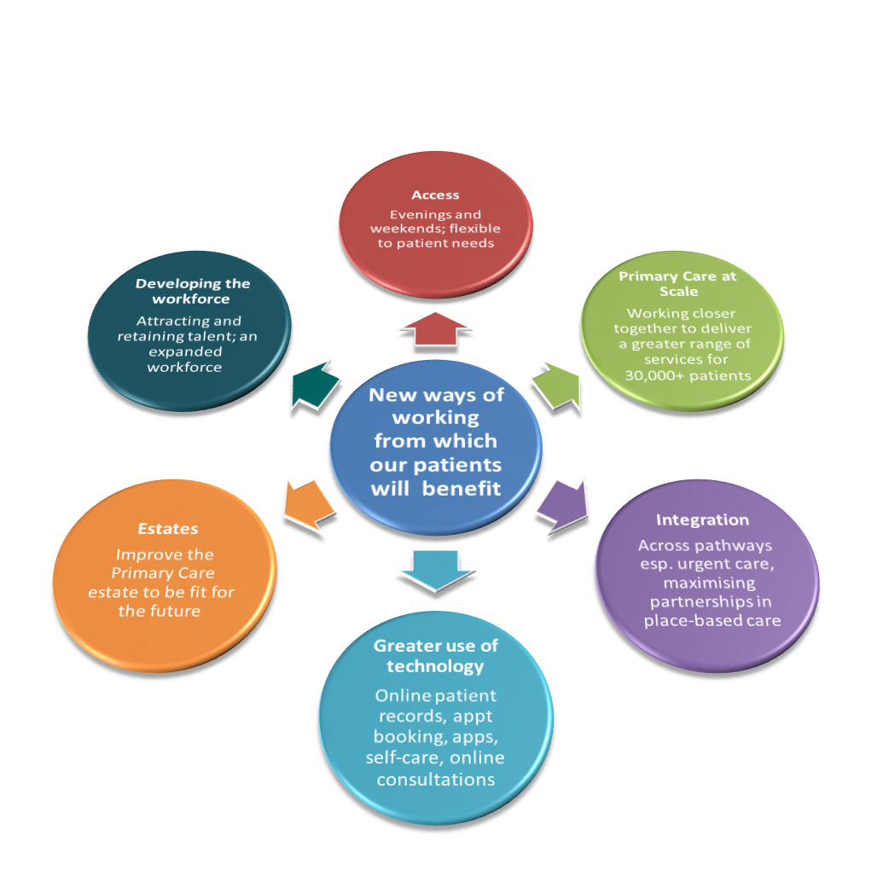
Gloucestershire STP: Our Primary Care Priorities
#GlosGPFV
Notes:
These are the priorities that form the basis of the strategy.
We are investing across these areas,
Access - Choice+, pre-book, same day appointments and after 6.30pm
New premises – developments
IT – supporting practices
Primary Care at scale – 30,000+ model – people and place
Primary Care strategy – patient version – In front of you – if you have questions please ask me or the team
Workforce – (detailed on the next slide)

Slide 17
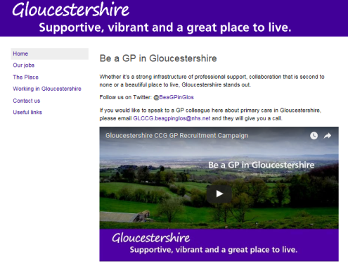
Gloucestershire STP: Primary Care Workforce
Focused on ‘Recruit, Retain, Return’ through GP-led Primary Care Workforce and Education Group
Now established Gloucestershire Community Education Provider Network (CEPN)
BMJ – “Be a GP in Gloucestershire”
Newly qualified GP scheme
Retainer GP scheme
Practice nurse education and training
New posts, with local and national funding, e.g. clinical pharmacists, frailty roles, mental health workers
#GlosGPFV
Notes:
This slide represents some of the work we’ve already started and will continue to do to support practices with:
Recruitment challenges and planning for the future
Pick off slide above to talk in more depth

Slide 18






General practice provides safe, high quality and efficient care, with very high levels of patient satisfaction. It has a unique and vital place in the NHS…
Holistic perspective understanding the whole patient not just a disease
Accessible, personal care built on a relationship from cradle to grave
First port of call and central point of care for all, for life
Comprehensive skills to diagnose & manage almost anything
Community based responsible for prevention and care of a registered population
Personal and population-orientated primary care is central …
if general practice fails, the whole NHS fails. Simon Stevens, General Practice Forward View
Notes:
National and local commitment to primary care:
Maximising on the many strengths that exist in primary care
Working towards efficiencies
Helping to make it easier for practices
Pick off topic area from above
Next slide (future patients and the hopes for them)

Slide 19


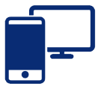

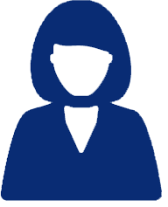





Flexible access to the right person at the right time
Empowered to play a greater role in staying well and caring for themselves, with access to comprehensive responsive care close to home.
Knowledge, skills, confidence and support
More care close to home
Notes:
For the patients:
Access – right person right time, flexibility in today’s demanding and busy world, everybody is busy and time is at a premium.
Skills and support
- Creating patient confidence in their health and using available and supportive technology for healthcare
– G-Care system set up for GPs. Patient facing G-Care timescales planned for December 2017.
Bringing care closer to home – ensuring the supply meets the demand

Slide 20










Innovations from around England that release time for GPs to do more of what only they can do.
bit.ly/gpcapacityforum
Notes:
1. Active signposting – you will hear about the work of a local practice before the workshops – training for the care to directed/navigated to the right place at the right time – community services – people don’t always need a GP appointment.
2. Consultation types – increasing phone appointments where appropriate and preferred by patient, E-Consultations,
3. Reduce DNA’s – easier cancellation, and appointment reminders
4. Develop the team – using GP’s for their specialist knowledge to be supported by very highly qualified and skilled individuals, skills mix to inc. minor illness nurses, practice pharmacists, direct access for physio therapists and mental health, physician associates, paramedics.
5. Productive work flows – creating efficiencies within practice systems – excellent approach locally taken by Saintbridge practice in Glos.
6. Personal productivity – leadership training, mentoring, peer support, computer and IT confidence
7. Partnership working: across specialisms in community settings outside of the hospital, more collaboration
8. Social prescribing – lots of development in county – CCG and GCC commitment to support this going forward – local solutions for local people - locality based.
9. Self care – use of IT technologies which are condition specific, focusing on prevention of disease, health coaching and support for living with Long term conditions
10. Encouraging local QI (quality improvement) approach – developing expertise in change management and leadership in primary care – connecting practices up with national training programmes and local STP training programmes.

Slide 21
Care Navigation/Active Signposting
JANUARY 2017
#GlosGPFV

Slide 22
Care Navigation
Wyndham Parry, Karen Rearie, Katie Stonall
JANUARY 2017
#GlosGPFV

Slide 23
Rosebank Health
Large practice (23700 patients)
  Recruitment & retention
  Sustainability and survival
Internal review to produce our own “new ways of working”
#GlosGPFV

Slide 24
Investments
LOTS of time & money
  GPs to evaluate
  Staff & staff training
Nurse Manager
New tier of Advanced Nurse Practitioners and the development of “Urgent Care Clinics”
Support staff
#GlosGPFV

Slide 25
Identified Areas
Signposting
Giving staff the tools/confidence
A-Z of clinical procedures and reviews
Staff training
Patient awareness
Workflow
Documentation
Non-NHS work
#GlosGPFV

Slide 26

Patient Signposting
#GlosGPFV

Slide 27
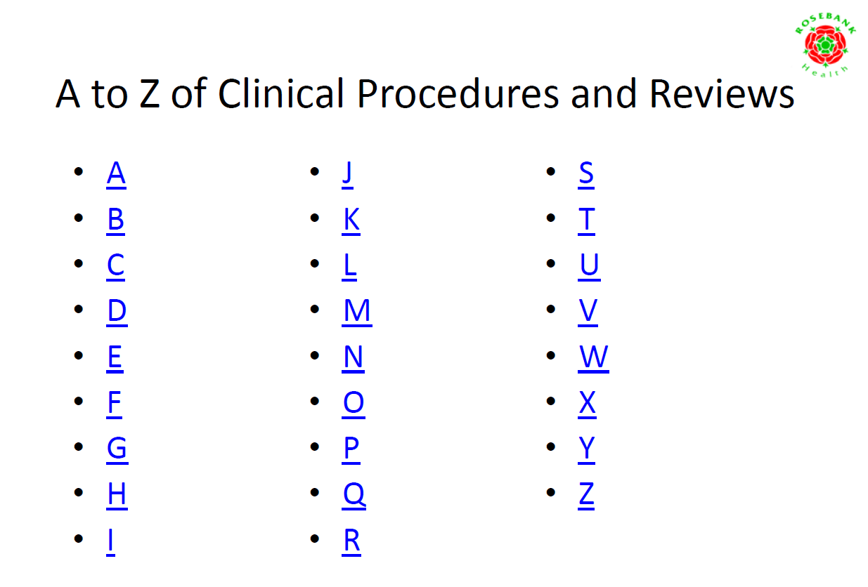

Slide 28
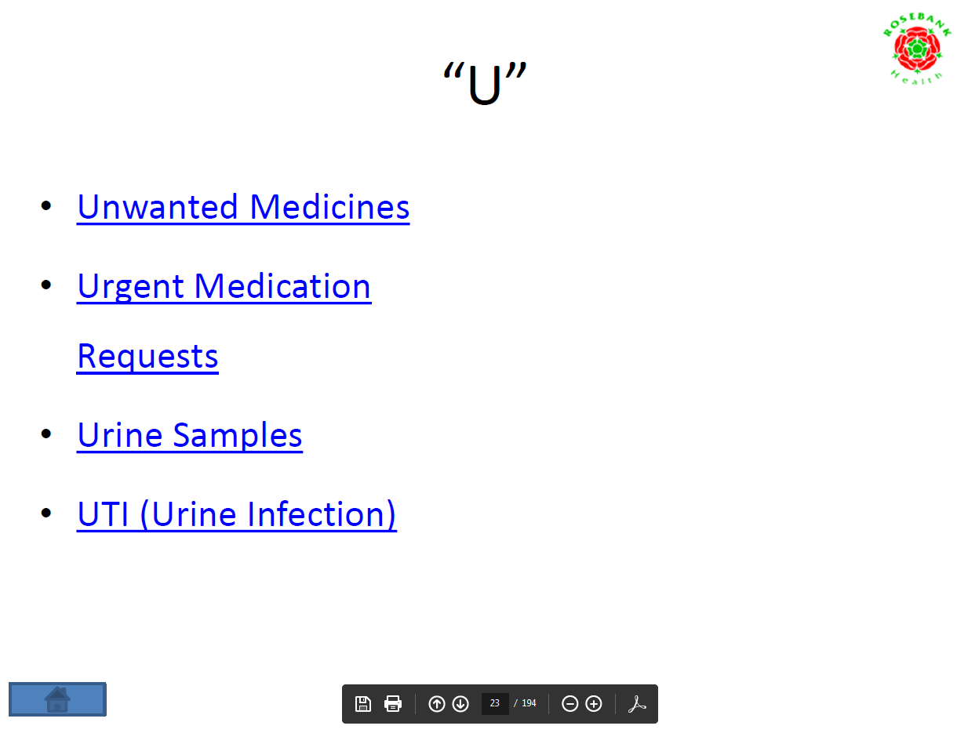

Slide 29
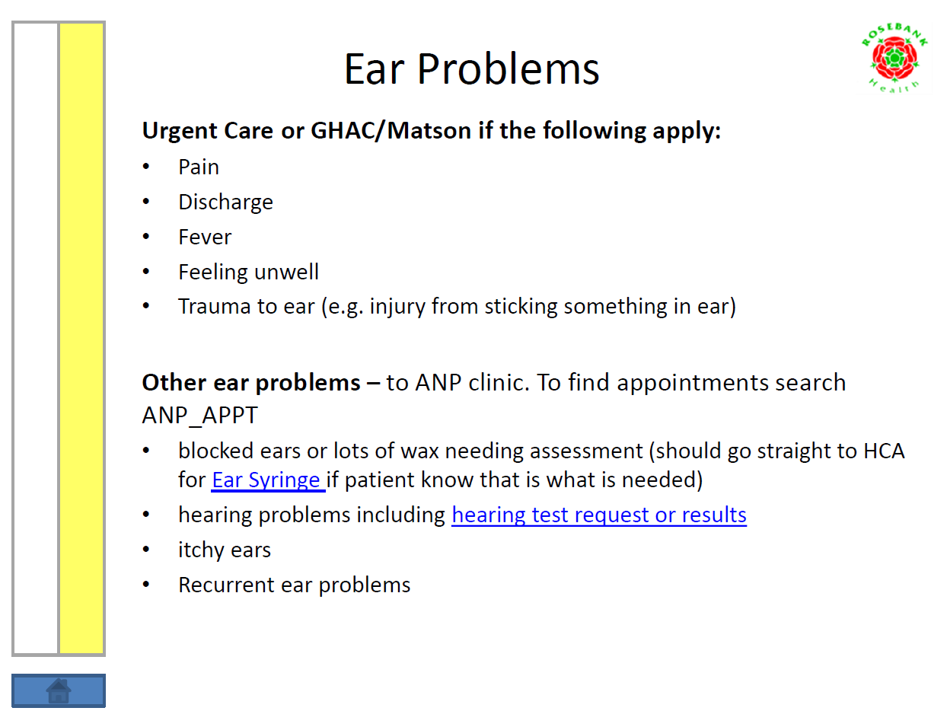
Slide Title:
Subtitle:
Text:
Bullet point
#GlosGPFV

Slide 30
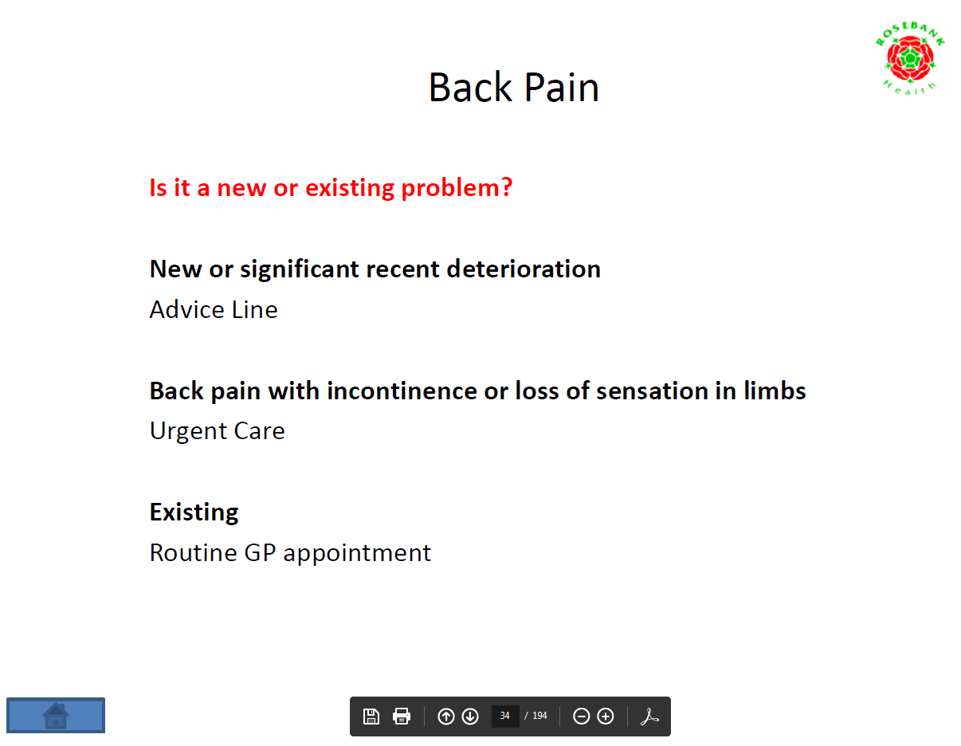
Slide Title:
Subtitle:
Text:
Bullet point
#GlosGPFV

Slide 31
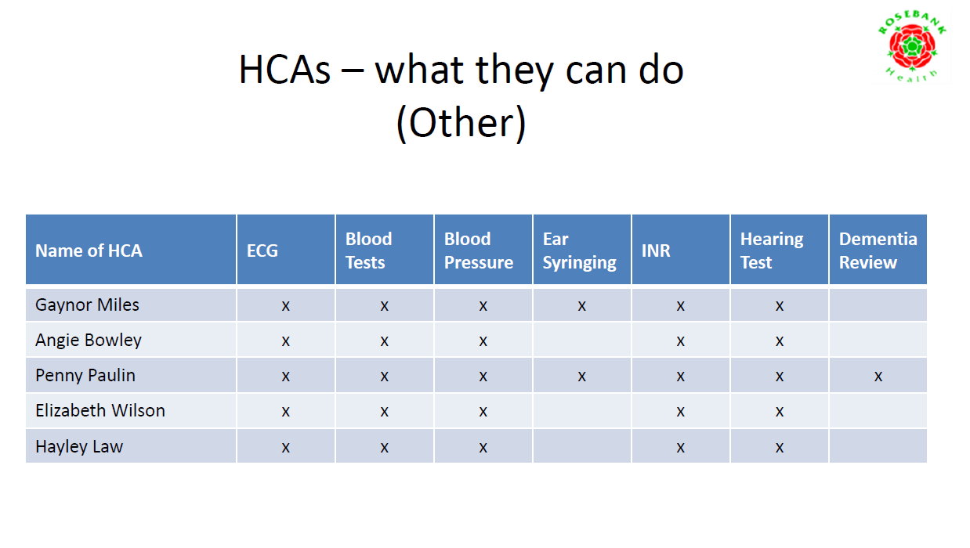

Slide 32
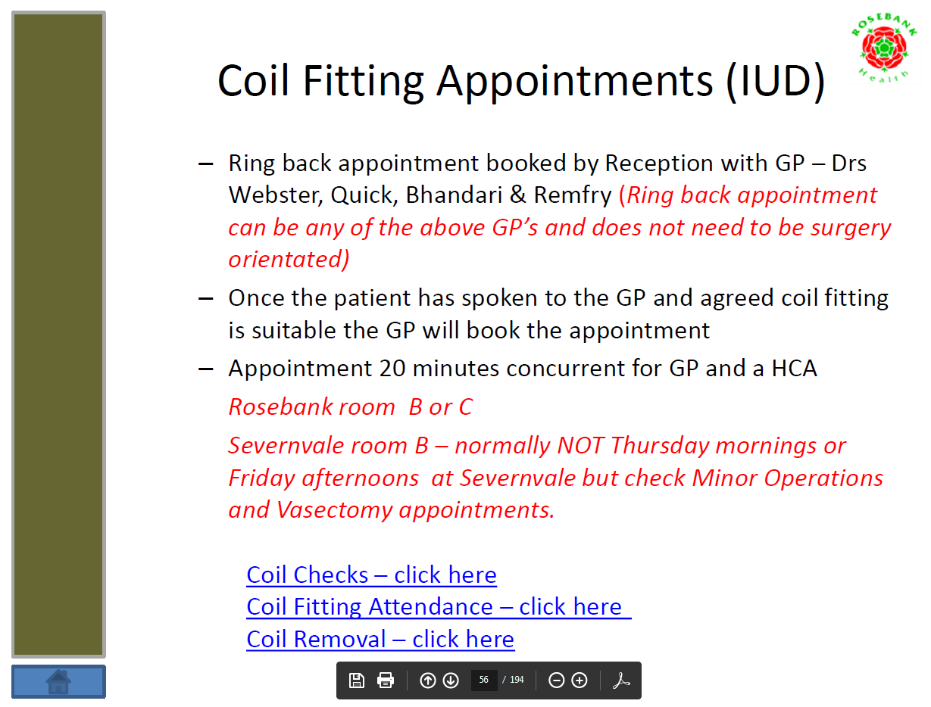
Slide Title:
Subtitle:
Text:
Bullet point
#GlosGPFV

Slide 33
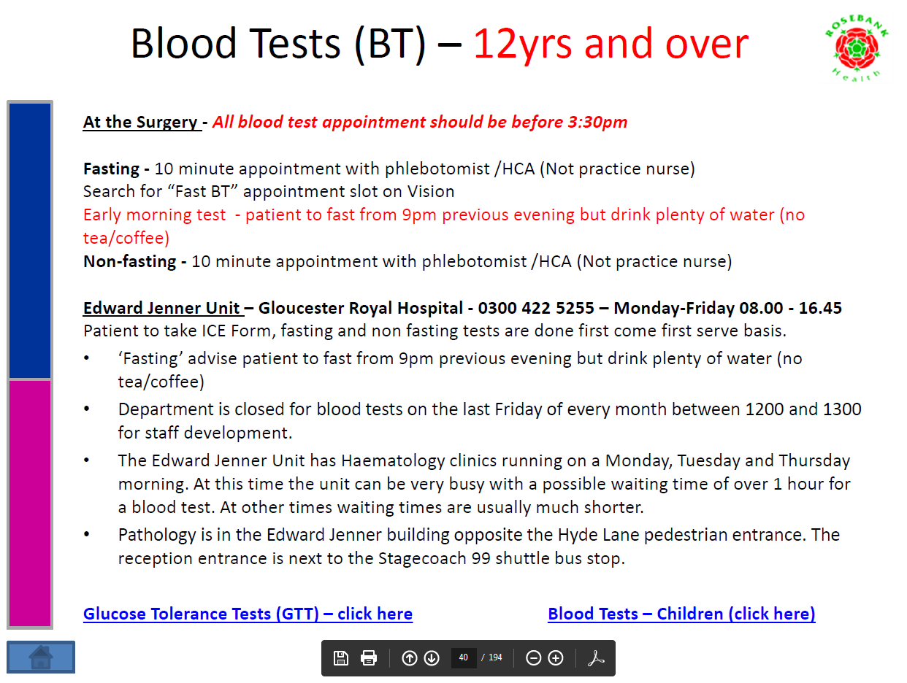
Notes:
.

Slide 34
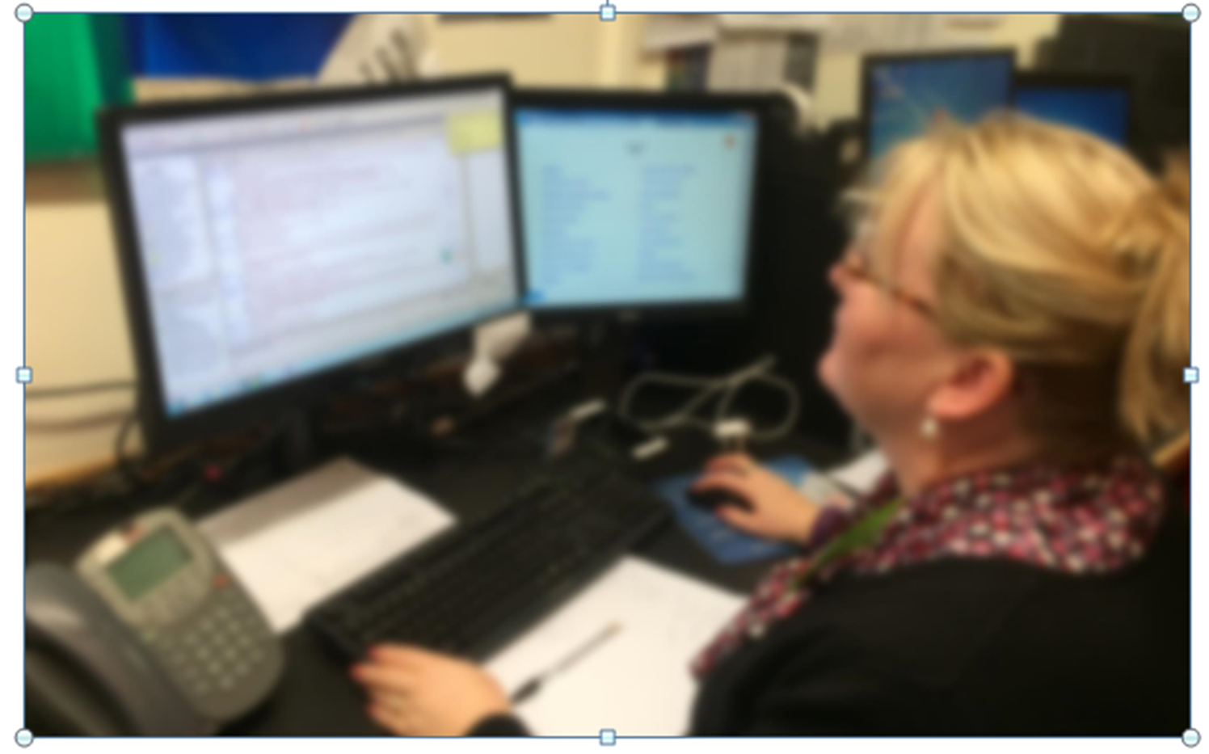
Slide Title:
Subtitle:
Text:
Bullet point
#GlosGPFV

Slide 35

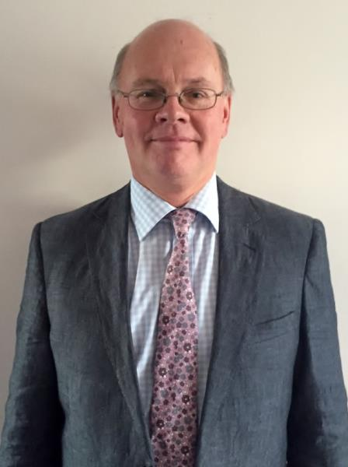

Patient Awareness
#GlosGPFV

Slide 36
Impact
Patients – this is a gradual process, but
Fewer complaints, more compliments
Faster turnaround for non-NHS work
Continual education
Staff
Improved team working
GPs
Reduced workload (but more complex patients)
More time for patients
Better work/life balance
#GlosGPFV

Slide 37

Impact
Small changes make a difference
Overall we believe our changes have saved Rosebank GP’s many hours over the last year
Further projects under way
#GlosGPFV

Slide 38

Recommendations
Invest - time & staff
Involve team
Look at skill mix and other resources
Continual Improvement – keep asking “Why?”
Share initiatives - we can all learn from one another
#GlosGPFV

Slide 39
Reducing medicines waste through public awareness
Chris Llewellyn & Georgina Smith

Slide 40
The problem
A 2008 audit estimated that that £4.5 million is being wasted through the cost of prescriptions
The CCG is not repeating this audit as we can see from the disposal of pharmaceutical waste at pharmacies and GPs that this trend continues
Pharmaceuticals are responsible for 1/5 of the carbon footprint of the NHS, all waste medicines have to be incinerated and cannot be reused or recycled
We need to reduce the amount of medicines waste in Gloucestershire

Slide 41
Our aim
Aim The overall aim is to reduce the waste of medicines through educating the public (patients) how they can help to reduce medicines waste through only ordering what they really need
Objective To increase public awareness of the problem of medicines waste and what people can do to help reduce the waste. To promote behaviours that result in a reduction of waste medicine.
How will this be measured? The number of items prescribed will be used as a proxy measure for increased awareness of medicines waste and thus a reduction in wasted medicines. The number of items ordered in the 12 months post campaign implementation will be compared to the 12 months pre campaign.

Slide 42
The current data
Pharmacy Waste. Pharmacy waste trends per year.
Cost of disposal of med waste £97,000
Weight 181 tonnes
Medicines prescribed
898,000 medicines prescribed ordered (1 month of data)

Slide 43
The public (patient) focussed behaviour change campaign
There are many projects taking place at the CCG which focus on improved prescribing practice e.g. repeat dispensing service where patients are asked to check all medications in bag
This project will focus on what patients can do to help support the reduction in medicines waste

Slide 44
Common myths
Unopened medicines returned to pharmacies/GP can be:
a) used by other people
b) recycled
NHS has plentiful funding to absorb waste costs
Medicines should be disposed of in the toilet/in the household waste
It is wise to keep a stock of medications at home just in case
ALL OF THESE ARE WRONG

Slide 45
The patient role
The Behaviour | The Patient Behaviour Change
Patients sometimes re-order medicines even though they have stopped taking them | Tell your doctor or pharmacist if you’re not taking any of your medicines for any reason.
Patients sometimes re-order medicines when they already have stock of that item at home. | Only order what you need - check your cupboards first and never stockpile medicines as this can be dangerous
Patients sometimes stop taking medication once they feel better and do not complete the full course | Take the full course of medication
Medication choice error | Check medications bag before leaving the Pharmacy

Slide 46
Gathering the PPG views
We would like to gather your thoughts on the style of materials used in the campaign
What wording, colours and theme do you think will be the most eye-catching and effective to engage with the public?

Slide 47
Video
https://www.youtube.com/watch?v=14LTXDmDgvg
https://www.youtube.com/watch?v=Rk48LuRm0BY
https://www.youtube.com/watch?v=5qzLRABf5cw

